Slide 1
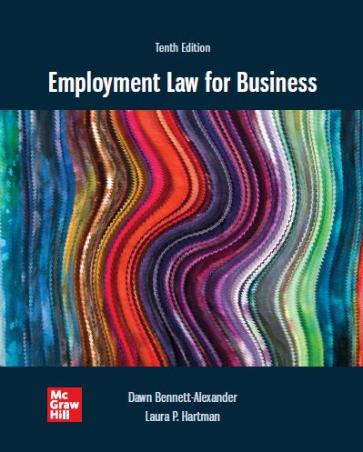
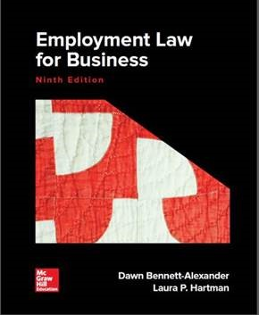
Chapter 6 Race and Color Discrimination
Copyright ©2022 McGraw-Hill Education. All rights reserved. No reproduction or distribution without the prior written consent of McGraw-Hill Education

Slide 2
Learning Objectives
Discuss and give important details on the history of race discrimination and civil rights issues in the United States.
Explain the relevance of the history of civil rights to present-day workplace race and color discrimination issues.
Set forth the findings of several recent studies on race inequalities.
Identify several ways that race and color discrimination are manifested in the workplace.
Explain why national origin issues have recently been included under race discrimination claims by the E E O C and why they remain different.
Describe ways in which an employer can avoid potential liability for race and color discrimination.

Slide 3
Statutory Basis
It shall be an unlawful employment practice for an employer—
(1) to fail or refuse to hire or to discharge any individual, or otherwise to discriminate against any individual with respect to his compensation, terms, conditions, or privileges of employment, because of such individual’s race, color . . . or
(2) to limit, segregate, or classify his employees or applicants for employment in any way which would deprive or tend to deprive any individual of employment opportunities or otherwise adversely affect his status as an employee, because of such individual’s race, color . . . [Title VII of the Civil Rights Act of 1964, as amended, 42 U.S.C. § 2000e-2(a).]

Slide 4
Introduction
Race is the first of the prohibited categories in Title VII
Remember: The primary focus of the Civil Rights Act was on Race (primarily African-Americans)
Southern Poverty Law Center issued a report in February 2011 showing that the number of hate groups in the United States has risen to over 1,000.
A 2008 USA Today/Gallup poll found
51 percent of whites, 59 percent of Hispanics, and 78 percent of blacks thought that racism against blacks is widespread
E E O C’s 2019 statistics still show that race discrimination claims account for one-third (35.3%) of total claims filed with EEOC
Remember: Two ways to prove race discrimination
Disparate Treatment
Direct racism
Indirect racism (i.e. McDonnell Douglas case)
Disparate Impact (i.e. Griggs case)
Enduring impact reflected in current race-related incidents and movements.
Do you feel Racism is as rampant today as in year’s past?

Slide 5
Recent Studies on Race Inequalities
Employers would rather hire a white man who had served time in prison than a black man who had not.
Applicants with ethnic names received fewer callbacks for jobs than the identical résumés with traditionally white names.
Linguistic profiling: African-Americans who leave messages in response to ads often never receive return calls, while whites almost always do.
Serious pay gaps persist along lines of race, gender and ethnicity.
Meta-analysis of every fieldwork experiment of hiring discrimination from 1989 through 2015 published in the Proceedings of the National Academy of Sciences in 2017 showed no change in racial discrimination in hiring since 1989. The results document a striking persistence of racial discrimination in U.S. labor markets.
Racial stereotypes and attitudes heavily influenced the labor market.
Majority of Americans say racism against blacks is widespread.

Slide 6
Evolving Definitions of Race
Traditional Title VII cases treated race as almost exclusively concerning African-Americans and whites.
Discrimination against other groups was considered primarily under the ‘national origin’ category.
E E O C’s Revised Race/National Origin Guidance
New forms of discrimination are emerging as workforce demographics evolve
Issue of race discrimination in America is multidimensional
Acknowledges evolving demographics of interracial families and ‘multidimensional’ issue of race discrimination
Increasing race and color charges alleging multiple or intersecting bases, e.g., age, gender, national origin etc.
Case: Case: Alonzo v. Chase Manhattan Bank, N.A.

Slide 7
E E O C’s Revised Race Guidance
Per Exhibit 6-6, Title VII’s prohibition of race discrimination encompasses:
Ancestry.
Physical characteristics.
Race-linked illness.
Culture and perception.
Association.
Subgroup or “race plus.”
“Reverse” race discrimination (against Caucasians).

Slide 8
E E O C’s National Origin Guidance
National origin discrimination is prohibited based on:
Employment Decisions.
Harassment.
Accent discrimination.
English fluency and English-only rules.
Coverage of foreign nationals.
Discrimination against individuals employed in the United States is prohibited regardless of citizenship.

Slide 9
Present-day Race Issues
‘New racism’ (belief that it’s been ‘solved’) - Idea that whites think everything is fair for everyone, so nothing need be done to ensure equal opportunity anymore.
Pushback of movements exposing systemic racism
Rise of concern for unconscious bias
‘Old racism’ incidents and charges also persist
Wet Seal clothing chain “fit” award $7.5 million (2012)
Cincinnati landlord ‘Whites Only’ pool sign (2013)
Incidents in Charlottesville (2017), Capitol Building (2021)
Case: Jones v. Horseshoe Casino and Hotel (2005)

Slide 10
Background of Racial Discrimination in the United States
History and its present-day effects account for much of the race discrimination seen today.
American slavery dates from 1619 (Cf. Mayflower pilgrims, 1620), and endured 247 years until after the US Civil War ended in 18 65.
Jim Crow laws were created after the Reconstruction.
Legalized and codified de jure racial discrimination system.
Slave Codes were simply renamed “Black Codes” and used virtually as if slavery had never ended.
‘Northern states’ de facto segregation less formal and public, still effective to maintain racial separation
Segregated public schools were outlawed by the U.S. Supreme Court in Brown v. Board of Education in 1954.
Civil Rights Act of 1964, Voting Rights Act (1965) crucial milestones
Voting Rights Act protections limited by Supreme Court in 2013 Shelby County v. Holder case
Race-based incidents endure across spectrum of American life

Slide 11
Thurgood Marshall – architect of 30-year campaign v. segregation

Slide 12
Race: Putting It All Together
Workplace as culture microcosm
Deep systemic penetration of race requires sustained attention
Dep’t. of Labor Glass Ceiling Studies, 19 91 and 19 95:
“Glass ceiling” exists beyond which minorities rarely progress.
Monitoring for equal access and opportunity was almost never considered a corporate responsibility.
Neither employee appraisals nor total compensation systems were usually monitored for bias.
More recent attention signals progress, but employer liability risk continues.
An employer must analyze and monitor workplace information based on “glass ceiling” considerations
Race discrimination can be discovered and addressed before it progresses to litigation

Slide 13
General Considerations
Title VII was enacted primarily in response to discrimination against African-Americans in the country, but the act applies equally to all.
Race discrimination can occur to any group and is equally prohibited under Title VII.
McDonald v. Santa Fe Transportation.

Slide 14
Recognizing Race Discrimination 1
The latest E E O C statistics for FY 2016 indicated:
Race remains one of the most frequent types of claim filed with the agency.
Many claims involve systemic race discrimination affecting hundreds of employees.
EEOC class action settlements in $millions
‘Garden variety’ racism still exists
Intentional, direct racism
Case: Jones v. Horseshoe Casino and Hotel
Often employers are held liable because they unconsciously treated employees of a particular race differently, or with poor understanding of the law
Case: Vaughn v. Edel
Disparate Treatment case, direct evidence…even though race played a part, if ER could have shown other reasons that would have led to EE’s dismissal, ER may would have won
Scenario 2

Slide 15
Recognizing Race Discrimination 2
Employers often unable to recognize behaviors that may be interpreted as race discrimination
Seemingly small or subtle cases of race discrimination.
Bradley v. Pizzaco of Nebraska, Inc., d/b/a Domino’s Pizza: facially neutral “no-beards” policy had disparate impact on 50% of African American men vs. 5% of whites. (Query: what could HR have done to prevent this expensive charge?)
Disparate Impact case….No beard policy…Bradley was dismissed b.c he wouldn’t comply with policy b.c it lead to a skin condition which impacted mostly African-Americans
Scenario 3.
Unusual manifestation of racial discrimination covered by Title VII.
Case: Chandler v. Fast Lane, Inc.: ‘opposition’
Disparate treatment and constructive discharge…ER can’t force EE to discriminate, EE is stil protected

Slide 16
Racial Harassment
Like sex harassment, it is a particular form of disparate treatment discrimination
a subset, rather than not a separate category
common elements with ‘hostile work environment’ sex harassment
Prima facie case elements:
Conduct is unwelcome.
Based on race.
So severe and pervasive that it alters the conditions of employment, creating an abusive environment.
There is a basis for imposing liability on the employer.

Slide 17
A Word About Color
Color has been a divisive issue for as long as African-Americans have been in the United States.
One of the five categories included in Title VII as a prohibited basis for discrimination.
Color discrimination can exist among people of the same race.
Color still matters a great deal in the workplace.
Scenario 1

Slide 18
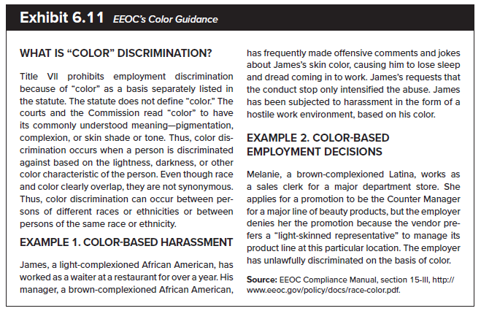
A Word About Color

Slide 19
Management Tips
Believe that race discrimination occurs and be willing to investigate it when it is alleged.
Make sure that there is a top-down message that the workplace will not tolerate race discrimination in any form.
Do not shy away from discussing race when the issue arises.
Provide a positive, nonthreatening, constructive forum for the discussion of racial issues.
Be aware of cultural differences that may be connected, at least in part, to race, when doing things at the workplace.
When an employee reports discrimination based on race, do not suggest that he or she must be mistaken.
Offer support groups if there is an expressed need.
Offer training in racial awareness and sensitivity. Courts have offered language indicating they will look more favorably on employers who do so.
Constantly monitor events such as workplace hiring, termination, training, promotion, raises, and discipline to ensure that they are fair and even-handed.

