Slide 1
Chapter 9 Attracting and Retaining the Best Employees

Slide 2
Human Resources Management: An Overview
Human resources, the people who work within an organization, are the most important and valuable resource for a business.
Human resources management (HRM) – all the activities involved in acquiring, maintaining, and developing an organization’s human resources
HRM Activities
Maintaining
Developing
Acquiring

Slide 3
HRM Activities: An Outline
HRM Activities
Acquiring Human Resources
Planning labor needs
Job Analysis
Recruiting
Selection
Orientating
Maintaining Human Resources
Employee Relations
Financial Compensation
Benefits
Developing Human Resources
Training and Development
Evaluating Labor (Performance Appraisals)
Legal Issues Impacting HRM

Slide 4
HRM Activities
Acquiring - Acquisition includes planning and the various activities that lead to hiring new personnel.
Altogether, the planning phase of HRM includes five separate activities:
Human resources planning – determining the firm’s future human resources needs
Job analysis – determining the exact nature of the positions
Recruiting – attracting people to apply for positions
Selection – choosing and hiring the most qualified applicants
Orientation – acquainting new employees with the firm

Slide 5
HRM Activities
Maintaining - Maintaining human resources consists primarily of encouraging employees to remain with the firm and to work effectively by using a variety of HRM programs, including the following:
Employee relations – increasing employee job satisfaction through satisfaction surveys, employee communication programs, exit interviews, and fair treatment
Compensation – rewarding employee effort through monetary payments
Benefits – providing rewards to ensure employee well-being
Development - The development phase of HRM is concerned with improving employees’ skills and expanding their capabilities.
The two important activities of this phase are:
Training and development – teaching employees new skills and new jobs, and more effective ways of performing their present jobs
Performance appraisal – assessing employees’ current and potential performance levels

Slide 6
Responsibility for HRM
In general, HRM is a shared responsibility of line managers and staff HRM specialists.
Specific HRM activities are assigned to those in the best position to perform them.
Human resources planning and job analysis are usually carried out by staff specialists with input from line managers.
Staff experts handle recruiting and selection, although line managers are involved in hiring decisions.
Staff specialists devise orientation programs that are carried out by both staff specialists and line managers.
Compensation systems (including benefits) most often are developed and administered by the HRM staff.
Training and development activities are the joint responsibility of staff and line managers.
Performance appraisal is the job of the line manager, although HRM personnel design the firm’s appraisal system in many organizations.

Slide 7
Human Resources Planning
Human resources planning – the development of strategies to meet a firm’s human resources needs
The organization’s overall strategic plan is the starting point of the process.
From this, human resource planners can forecast future demand for human resources.
Next, the planners must determine whether the needed human resources will be available.
Finally, they have to take steps to match supply with demand.

Slide 8
Forecasting Human Resources Demand
Planners should base human resource demand forecasts on all relevant information available.
The firm’s overall strategic plan will provide information about future business ventures, new products, and projected expansions or contractions of specific product lines.
Information on past staffing levels, evolving technologies, industry staffing practices, and projected economic trends also can be helpful.
Technological advances are creating new opportunities in forecasting and planning for human resources demand.
Insights gained from such technology can help managers develop more cost-effective recruiting and selection strategies as well as recognize threats and opportunities.
HRM managers use forecasting information to determine both the number of employees required and their qualifications.

Slide 9
Forecasting Human Resources Supply
A forecast of human resources supply must take into account both the present workforce and any changes that may occur within it.
Two useful techniques for forecasting human resources supply are the replacement chart and the skills inventory.
Replacement chart – a list of key personnel and their possible replacements within a firm
Skills inventory – a computerized data bank containing information on the skills and experience of all present employees

Slide 10
Matching Supply with Demand
Demand > Supply
Hire – Bring in new employees
Promote – Put existing employees in new, “better” positions
Transfer – Moving an existing employee to a different position
Supply > Demand
Laid Off – termination for economic or business reason
Fire – terminating the employee for performance reasons
Attrition – normal reduction of the work force that occurs when
employees leave the firm on their own accord
(retire, find another job)
Early Retirement – letting employees within a few years of retirement
retire early and allowing them to receive their full benefits

Slide 11
Cultural Diversity in Human Resources
Today’s workforce is highly diverse, with employees bringing a wide variety of beliefs, expectations, and behavioral norms to the workplace.
Managers must be aware of these differences.
Examples: European businesspeople may offer a kiss on the cheek as a greeting; Latin Americans tend to stand closer to people with whom they are talking than North Americans prefer.
Cultural (or workplace) diversity – differences among people in a workforce owing to race, ethnicity, and gender
Although cultural diversity presents a challenge, managers should view it as an opportunity rather than a limitation.
Numerous U.S. firms have trained their managers to respect and manage diversity.
Diversity training programs may include:
Recruiting minorities
Training minorities to be managers
Training managers to view diversity positively
Teaching English as a second language
Facilitating support groups for immigrants
A diversity program will be successful only if it:
Is systematic
Is ongoing
Has a strong, sustained commitment from top leadership

Slide 12
TABLE 9-1 Advantages of Cultural Diversity
Economic Measure | Description
Cost | The cost of poorly integrating workers increases with diversity. However, companies that handle diversity well can create cost advantages over those that do a poor job. Companies can also reduce costs by hiring culturally sensitive and trained workers.
Resource acquisition | Companies develop reputations as being favorable or unfavorable employers for women and ethnic minorities. Those with the best reputations will attract and retain the best personnel.
Marketing edge | For multinational organizations, the insight and cultural sensitivity that come from an international perspective should improve marketing efforts. The same rationale applies to marketing subpopulations domestically.
Flexibility | Culturally diverse employees often are open to a wider array of positions within a company and are more likely to move up the corporate ladder rapidly.
Creativity | Diversity of perspectives and less emphasis on conformity to norms of the past should improve the level of creativity.
Problem solving | Differences within decision-making and problem-solving groups potentially produce better decisions through a wider range of perspectives and more thorough critical analysis of issues.
Bilingual skills | Cultural diversity in the workplace is valuable in the global marketplace. Employees with knowledge about another country and who can communicate in that language can prevent embarrassing mistakes due to a lack of cultural sophistication. Thus, many companies seek job applicants with a background in cultures in which the company does business.

Slide 13
Job Analysis
Job analysis – a systematic procedure for studying jobs to determine their various elements and requirements
The job analysis for a particular position consists of two parts.
1. Job description – a list of the elements that make up a particular job (duties, responsibilities, working conditions, tools and equipment required to do job, rate of pay)
2. Job specification – a list of the qualifications required to perform a particular job (skills, abilities, education, and experience)

Slide 14
FIGURE 9-1 Job Description and Job Specification

Slide 15
Recruiting
Recruiting – the process of attracting qualified job applicants
Recruiters may seek applicants outside the firm, within the firm, or both.
Internal recruiting – considering present employees as applicants for available positions
Advantages:
Provides strong motivation for current employees
Helps the firm to retain quality personnel
Disadvantages:
Leaves another position open
Thus, the firm not only incurs recruiting and selection costs, but it also must train two employees instead of one.
External recruiting – attracting job applicants from outside an organization
External recruiting may include:
Activities on college campuses and open houses
Soliciting recommendations from current employees
Posting in newspapers
Employment agencies
Online
Advantage:
Brings people into a firm who have new perspectives and varied business backgrounds
Disadvantages:
Is often expensive
May provoke resentment among present employees

Slide 16
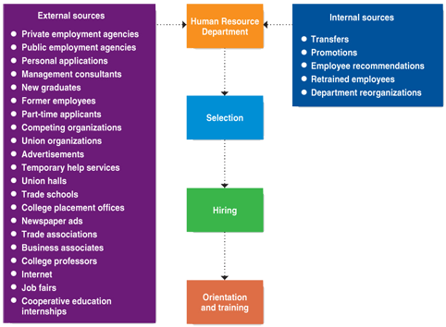
Recruiting Sources

Slide 17
Selection (i.e. Hiring)
Selection – the process of gathering information about applicants for a position and then using that information to choose the most appropriate applicant
Employment Applications
Resumes
Employment Tests
Interviews
References
Social Media

Slide 18
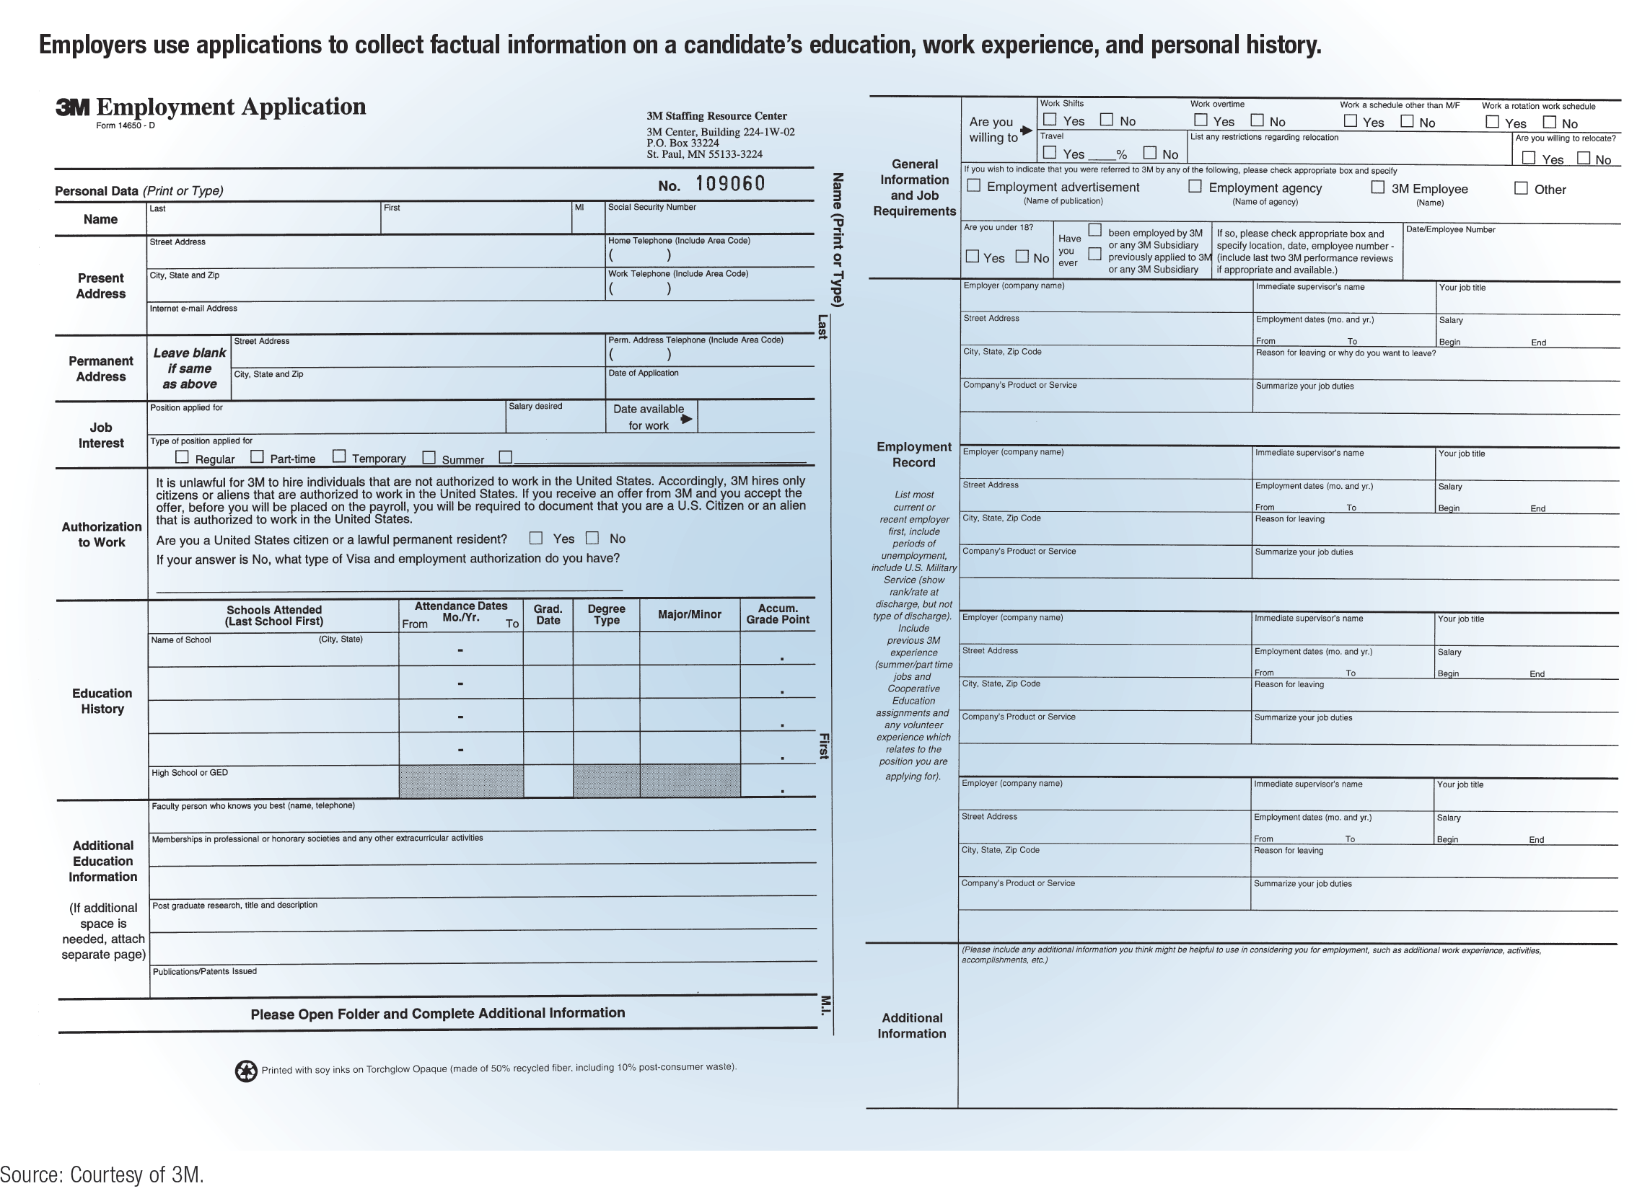
FIGURE 9-2 Typical Employment Application

Slide 19
Orientation
Soon after a candidate joins a firm, he or she goes through the firm’s orientation program.
Orientation – the process of acquainting new employees with an organization
Orientation topics range from the location of the company cafeteria to career paths within the firm.
May be brief and informal or long and formal
Introduces employees to the company culture
Strong orientation programs reduce employee turnover

Slide 20
Compensation Decisions
Compensation – the payment employees receive in return for their labor
Compensation system – the policies and strategies that determine employee compensation
For most firms, designing an effective compensation system requires three separate management decisions:
Wage level
Wage structure
Individual wages

Slide 21
Compensation Decisions
Wage Level
Management first must position the firm’s general pay level relative to pay levels of comparable firms.
To determine the average pay for a job, the firm may use wage surveys.
Wage survey – a collection of data on prevailing wage rates within an industry or a geographic area
Wage Structure
Next, management must determine the wage structure by deciding on relative pay levels for all the positions within the firm.
The wage structure is developed on the basis of a job evaluation.
Job evaluation – the process of determining the relative worth of the various jobs within a firm
Individual Wages
Finally, the company must determine the specific payments individual employees will receive.

Slide 22
Comparable Worth
Comparable worth – a concept that seeks equal compensation for jobs requiring about the same level of education, training, and skills
In recent decades, many states have taken steps to ensure that all workers have equal pay for comparable worth.
A few companies have taken steps to address the situation by publicizing the results of their investigations into their own pay gaps.
Examples: Amazon, Apple, the Gap, GoDaddy, Google, Intel, and SpaceX have disclosed the results of reviews of employee pay to highlight their lack of a pay gap.

Slide 23
Types of Compensation
Most forms of compensation fall into the following categories:
Hourly wage – a specific amount of money paid for each hour of work
Salary – a specific amount of money paid for an employee’s work during a set calendar period, regardless of the actual number of hours worked
Commission – a payment that is a percentage of sales revenue
Incentive payment – a payment in addition to wages, salary, or commissions
Lump-sum salary increase – an entire pay raise taken in one lump sum
Profit-sharing – the distribution of a percentage of a firm’s profit among its employees

Slide 24
Employee Benefits
Employee benefit – a reward in addition to regular compensation that is provided indirectly to employees
Types of Benefits
Employee benefits take a variety of forms.
Pay for time not worked
Covers such absences as vacation, holidays, and sick leave
Insurance packages
Include health, life, vision, and dental insurance
Pension and retirement programs
May be borne entirely by the firm or shared with the employee
Unemployment insurance
Social Security
Workers’ compensation insurance
Pays medical bills for injuries that occur on the job and provides income for employees who are disabled by job-related injuries
Other benefits
Include tuition-reimbursement plans, credit unions, child-care services, company cafeterias, and exercise rooms
Flexible Benefit Plans
Flexible benefit plan – compensation plan whereby an employee receives a predetermined amount of benefit dollars to spend on a package of benefit he or she has selected to meet individual needs

Slide 25
Training and Development
Training and development are usually differentiated as employee training or management development.
Employee training – the process of teaching operations and technical employees how to do their present jobs more effectively and efficiently
Management development – the process of preparing managers and other professionals to assume increased responsibility in both present and future positions (i.e. enhancing current skills and knowledge)

Slide 26
Analysis of Training Needs
When thinking about developing a training program, managers first must determine if training is actually needed and, if so, what types of training needs exist.
Employers may find that sometimes employees need motivation more than they need training.

Slide 27
Training and Development Methods
On-the-job
New employee learns by working under the supervision of experienced employee
Simulation
Training in an area that replicates the actual work environment without the day-to-day pressures
Classroom teaching and lectures
For large groups who need the same information (e.g., notification of change in benefits)
Conferences and seminars
Experts and learners meet to discuss problems and exchange ideas
Role playing
Acting out the roles of others in the organization for a better understanding of those roles

Slide 28
Evaluation of Training and Development
To ensure that training and development are as cost-effective as possible, the managers responsible should evaluate the company’s efforts periodically.
The results of training evaluations should be made known to all those involved in the program—including trainees and upper management.

Slide 29
Performance Appraisal
Performance appraisal – the evaluation of employees’ current and potential levels of performance to allow managers to make objective human resources decisions
The process has three main objectives:
Managers use performance appraisals to let workers know how well they are doing and how they can improve in the future.
A performance appraisal provides an effective basis for distributing rewards, such as pay raises and promotions.
Performance appraisal helps the organization monitor its employee selection, training, and development activities.

Slide 30
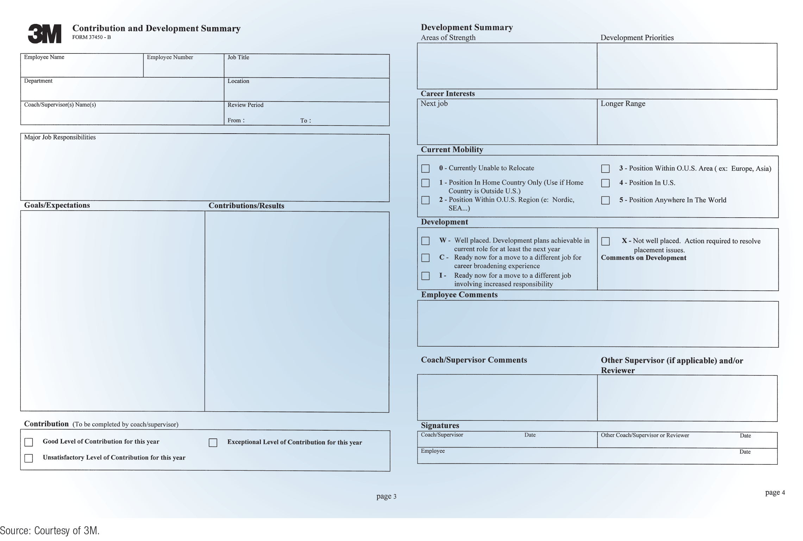
FIGURE 9-3 Performance Appraisal

Slide 31
Common Evaluation Techniques
Objective Methods
Objective appraisal methods use some measurable quantity as the basis for assessing performance.
Examples: units of output, dollar volume of sales, and number of defective products
Judgmental Methods
Judgmental appraisal methods require that the manager judge or estimate the employee’s performance level.
These methods are based on employee ranking or rating scales.
When ranking is used, the manager ranks subordinates from best to worst.
A rating scale consists of a number of statements, on which each employee is rated based on the degree to which the statement applies.

Slide 32
Performance Feedback
There are three major approaches to performance feedback interviews:
Tell and sell
The superior tells the employee how good or bad the employee’s performance has been and attempts to persuade the employee to accept the evaluation.
Tell and listen
The supervisor tells the employee what the employee has done right and wrong and then gives him or her a chance to respond.
Problem solving
Employees evaluate their own performance and set their own goals for future performance.
Another approach that has become popular is called a 360-degree evaluation.
A 360-degree evaluation collects anonymous reviews about an employee from his or her peers, subordinates, and supervisors and compiles them into a feedback report for the employee.

Slide 33
TABLE 9-2 Federal Legislation Affecting Human Resources Management (slide 1 of 3)
Law | Purpose
National Labor Relations Act (1935) | Established a collective-bargaining process in labor-management relations and the National Labor Relations Board (NLRB).
Fair Labor Standards Act (1938) | Established a minimum wage and an overtime pay rate for employees working more than 40 hours per week.
Labor-Management Relations Act (1947) | Provides a balance between union power and management power, also known as the Taft–Hartley Act.
Equal Pay Act (1963) | Specifies that men and women who do equal jobs must be paid the same wage.
Title VII of the Civil Rights Act (1964) | Prohibits discrimination in employment practices based on sex, race, color, religion, or national origin.

Slide 34
TABLE 9-2 Federal Legislation Affecting Human Resources Management (slide 2 of 3)
Law | Purpose
Age Discrimination in Employment Act (1967–1986) | Prohibits personnel practices that discriminate against people aged 40 years and older. The 1986 amendment eliminated a mandatory retirement age.
Occupational Safety and Health Act (1970) | Regulates the degree to which employees can be exposed to hazardous substances and specifies the safety equipment that the employer must provide.
Employment Retirement Income Security Act (1974) | Regulates company retirement programs and provides a federal insurance program for retirement plans that go bankrupt.
Worker Adjustment and Retraining Notification (WARN) Act (1988) | Requires employers to give employees 60 days notice regarding plant closure or layoff of 50 or more employees.

Slide 35
TABLE 9-2 Federal Legislation Affecting Human Resources Management (slide 3 of 3)
Law | Purpose
Americans with Disabilities Act (1990) | Prohibits discrimination against qualified individuals with disabilities in all employment practices, including job-application procedures, hiring, firing, advancement, compensation, training, and other terms, conditions, and privileges of employment.
Civil Rights Act (1991) | Empowers employees to sue employers for sexual discrimination and collect punitive damages.
Family and Medical Leave Act (1993) | Requires an organization with 50 or more employees to provide up to 12 weeks of leave without pay on the birth (or adoption) of an employee’s child or if an employee or his or her spouse, child, or parent is seriously ill.
Affordable Care Act (2010) | Requires an organization with 50 or more employees to make health insurance available to employees or pay an assessment and gives employees the right to buy health insurance from another provider if an organization’s health insurance is too expensive.

