Slide 1
Chapter 7 Creating a Flexible Organization

Slide 2
Structuring an Organization?
Create a division of labor
Set up teams or departments
Allocate resources
Assign tasks
Establish procedures
Adjust to new realities

Slide 3
What Is an Organization?
Organization – a group of two or more people working together to achieve a common set of goals
Examples: a neighborhood dry cleaner owned and operated by a husband-and-wife team, IBM, Home Depot
Organization chart – a diagram that represents the positions and relationships within an organization
The chain of command can be short or long, depending on the organization’s size.
Not everyone who works for an organization is part of the direct chain of command, such as those who hold advisory, or staff, positions.
Chain of command – the line of authority that extends from the highest to the lowest levels of an organization
Hierarchy - A system in which one person is at the top of an organization and there is a ranked or sequential ordering from the top down.

Slide 4
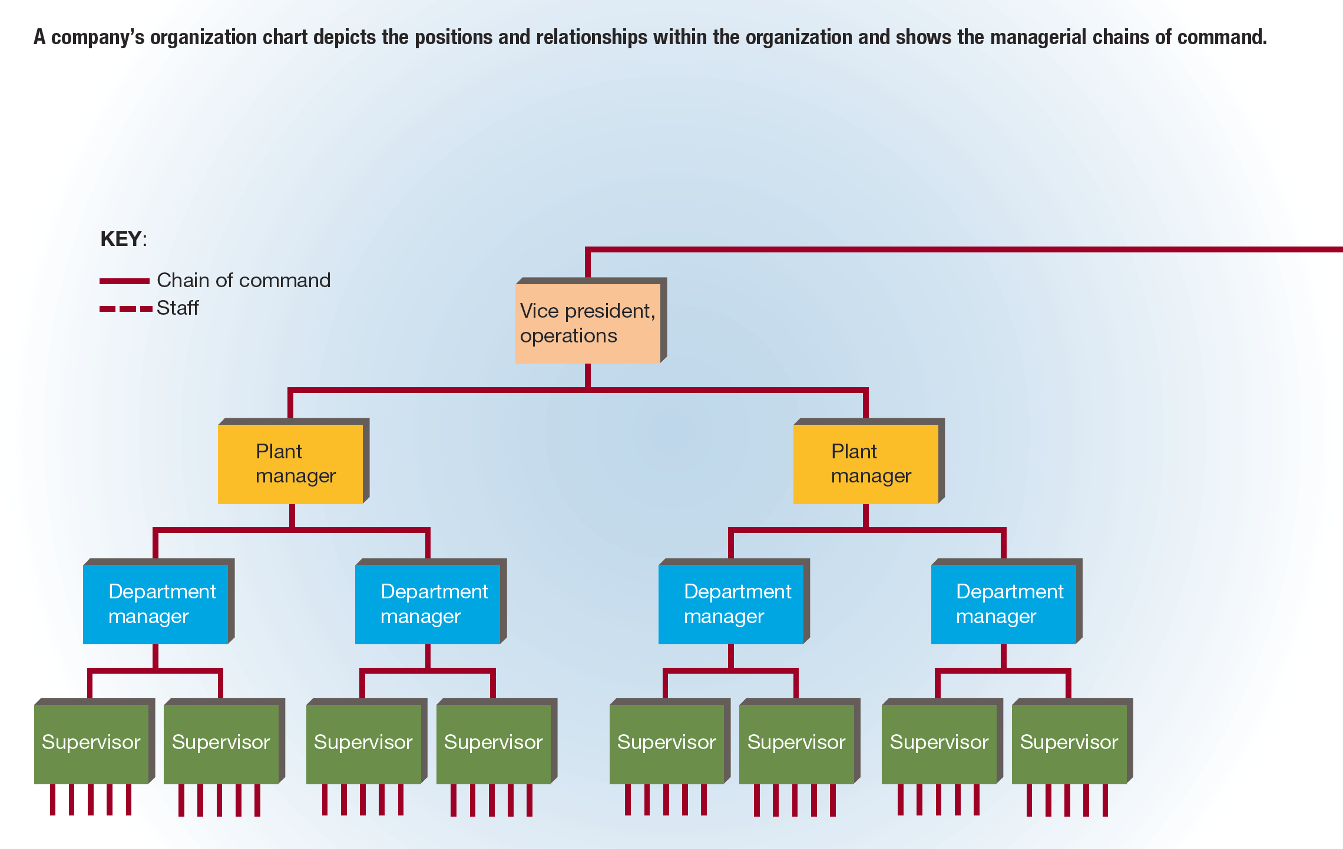
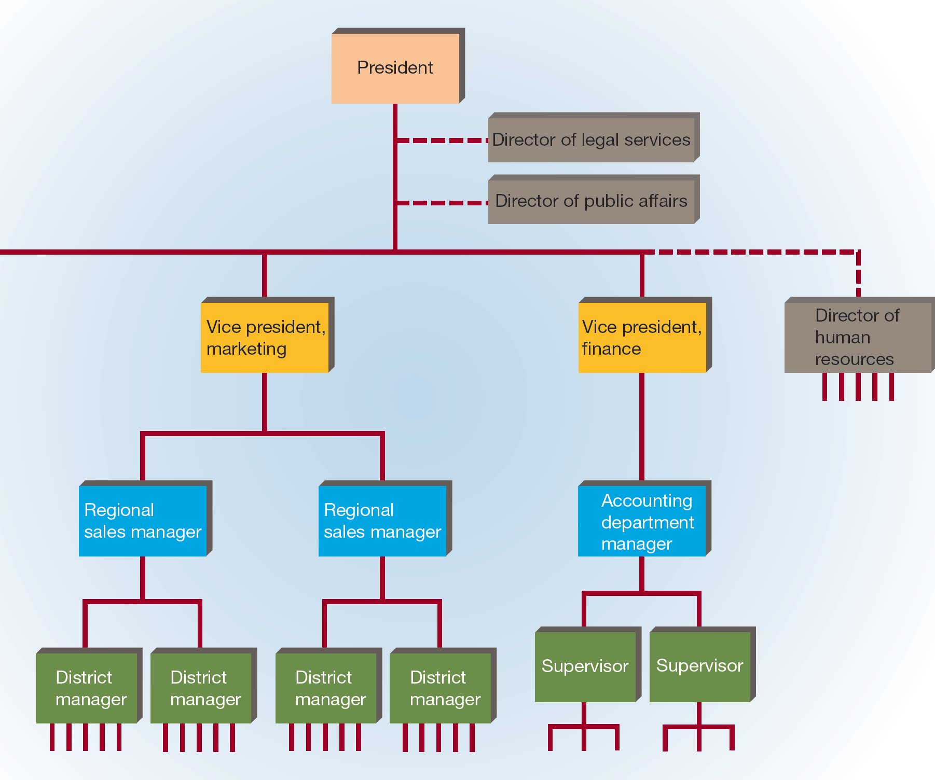
FIGURE 7-1 A Typical Corporate Organization Chart

Slide 5
What Is an Organization?
Most smaller organizations find organization charts useful.
They clarify positions and relationships for everyone in the organizational structure.
However, many large organizations, such as ExxonMobil, Kellogg’s, and Procter & Gamble, do not maintain complete, detailed charts.
It is difficult to chart even a few dozen positions accurately, much less the thousands that characterize larger firms.
Larger organizations are almost always changing parts of their structure; thus, an organization chart would be outdated before it was completed.

Slide 6
Major Considerations of Structuring an Organization
Job design
Divide work into parts or tasks and assign positions to those parts
Departmentalization
Group the positions into manageable units or departments
Delegation
Assign part of a manager’s work and power to other workers
Span of management (control)
The number of workers who report directly to one manager (wide vs. narrow)
Degree of Centralization
The extent to which decision-making power is held by a small number of people at the top of the organization (tall vs. flat)
Chain of command
Designate the positions with direct authority and those that are support positions (i.e. create LINE and STAFF hierarchy)

Slide 7
Job Design
Job Design - structuring the tasks and activities required to accomplish a firm’s objectives into specific jobs so as to foster productivity and employee satisfaction
BROAD JOB RESPOSIBILITY VS. JOB SPECIALIZATION
Many jobs or tasks (BROAD) or single or few jobs (SPECIALIZATION)?
Which is better? Does it matter? Cost and work considerations?

Slide 8
Job Specialization
Job specialization – the separation of all organizational activities into distinct tasks and the assignment of different tasks to different people
The rationale behind job specialization:
Some job specialization is necessary in every organization because the “job” of most organizations is too large for one person to handle.
When a worker has to learn one specific, highly specialized task, that individual can learn it quickly and perform it efficiently.
A worker repeating the same job does not lose time changing operations.
The more specialized the job, the easier it is to design specialized equipment.
The more specialized the job, the easier the job training.
The most significant drawback of job specialization is the boredom and dissatisfaction employees may feel when repeating the same job.

Slide 9
Alternatives to Job Specialization
Job rotation – the systematic shifting of employees from one job to another
Example: A worker may be assigned a different job every week for a four-week period and then return to the first job in the fifth week.
Helps workers:
Stay interested in their jobs
Develop new skills
Identify new roles where they may want to focus their energies in the future
Job enlargement
Job enrichment

Slide 10
Departmentalization
Departmentalization – the process of grouping jobs into manageable units
The most common bases for organizing a business into effective departments are by:
Function
Product
Location
Customer

Slide 11
By Function
Departmentalization by function – grouping jobs that relate to the same organizational activity
Example: All marketing personnel are grouped together in the marketing department, all production personnel in the production department, and so on.
Most smaller and newer organizations departmentalize by function.
Advantages:
Simplified supervision
Easy coordination
Disadvantages:
Slow decision making
Tends to emphasize the department over the organization as a whole

Slide 12
By Product
Departmentalization by product – grouping activities related to a particular product or service
This approach is used often by older and larger firms that produce and sell a variety of products.
Advantages:
Easier decision making
Provides for the integration of all activities associated with each product
Disadvantages:
Causes some duplication of specialized activities between departments
Tends to emphasize the product over the organization as a whole

Slide 13
By Location
Departmentalization by location – grouping activities according to the defined geographic area in which they are performed
Departmental areas may range from whole countries to regions within countries to areas of several city blocks.
Example: Ford has divisions for the Americas, Europe, Asia, Asia Pacific and Africa, and China.
Advantage:
Allows the organization to respond readily to the unique demands or requirements of different locations
Disadvantage:
Often requires a large administrative staff and an elaborate control system to coordinate operations across many locations

Slide 14
By Customer
Departmentalization by customer – grouping activities according to the needs of various customer populations
Advantage:
Allows the firm to deal efficiently with unique customers or customer groups
Disadvantage:
Requires a larger-than-usual administrative staff

Slide 15
Combinations of Bases
Many organizations use a combination of departmentalization bases.
Example: Toyota has product divisions such as R&D and Engineering, Compact Car Company, Mid-size Vehicle Company, CV Company, Lexus International Company, Power Train Company, and Connected Company, as well as divisions based on locations.

Slide 16
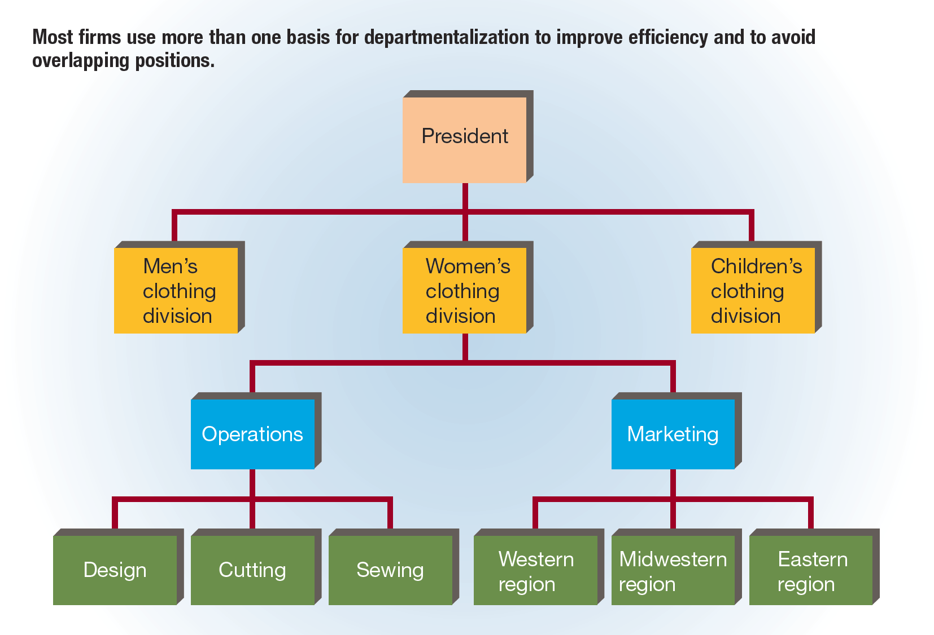
FIGURE 7-2 Multibase Departmentalization for New-Wave Fashions, Inc.

Slide 17
Delegation, Decentralization, and Centralization
Delegation – assigning part of a manager’s work and power to other workers
The degree of centralization or decentralization of authority is determined by the overall pattern of delegation within the organization.
Steps in Delegation
The delegation process generally involves three steps.
The manager must assign responsibility.
Responsibility – the duty to do a job or perform a task
The manager must grant authority.
Authority – the power, within an organization, to accomplish an assigned job or task
The manager must create accountability.
Accountability – the obligation of a worker to accomplish an assigned job or task

Slide 18
FIGURE 7-3 Steps in the Delegation Process

Slide 19
Delegation of Authority
Barriers to Delegation
For several reasons, managers may be unwilling to delegate work.
The manager does not trust the employee to complete the task.
The manager fears the employee will perform exceptionally and attract the notice of higher-level managers.
The manager may be disorganized and is not able to plan and assign work effectively.

Slide 20
Decentralization of Authority
Decentralized organization – an organization in which management consciously attempts to spread authority widely in the lower levels of the organization
Example: Berkshire Hathaway
Centralized organization – an organization that systematically works to concentrate authority at the upper levels of the organization
Example: UPS

Slide 21
Decentralization of Authority
Factors that influence the extent of decentralization:
The external environment in which the firm operates
The more complex and unpredictable this environment, the more likely it is that top management will let lower-level managers make important decisions because lower-level managers are closer to the problems.
The nature of the decision itself
The riskier or more important the decisions that have to be made, the greater is the tendency to centralize decision making.
The abilities of lower-level managers
If these managers do not have strong decision-making skills, top managers will be reluctant to decentralize.
Traditional practice
A firm that has practiced centralization or decentralization is likely to maintain that same posture in the future.

Slide 22
The Span of Management
Span of management (or span of control) – the number of workers who report directly to one manager
Wide and Narrow Spans of Management
A wide span of management exists when a manager has a larger number of subordinates.
A narrow span exists when the manager has only a few subordinates.

Slide 23
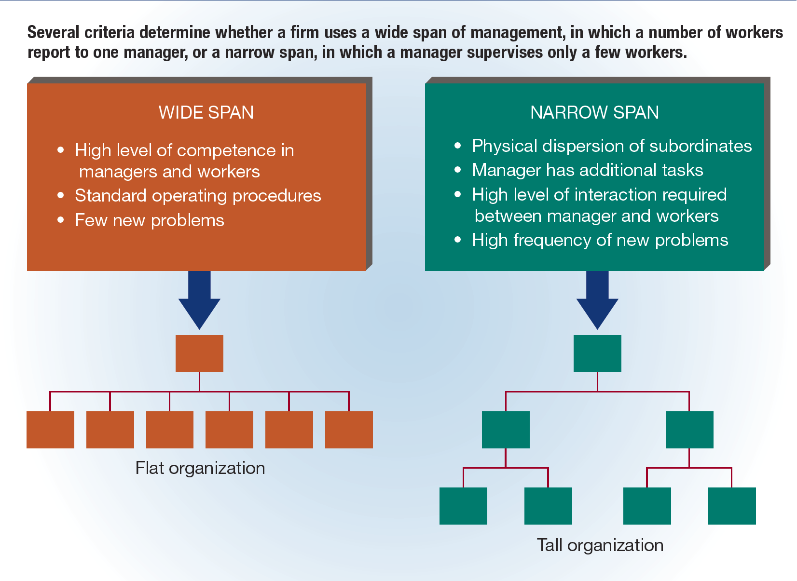
FIGURE 7-4 The Span of Management

Slide 24
The Span of Management
Organizational Height
Organizational height – the number of layers, or levels, of management in a firm
If the span of management is wide, fewer levels are needed, and the organization is flat.
If the span of management is narrow, more levels are needed, and the organization is tall.

Slide 25
Forms of Organizational Structure
Line structure
Line-and-staff structure
Matrix structure
Network structure

Slide 26
The Line Structure
Line structure – an organizational structure in which the chain of command goes directly from person to person throughout the organization
A straight line could be drawn down through the levels of management, from the chief executive down to the lowest level in the organization.
Line managers – a position in which a person makes decisions and gives orders to subordinates to achieve the organization’s goals
Advantage:
Line managers can make decisions quickly with direct accountability because the decision maker only has one supervisor to report to.
Disadvantage:
Line managers are responsible for many activities, and therefore must have a wide range of knowledge about all of them.
Line structures are not very effective in medium- or large-sized organizations.

Slide 27
The Line-and-Staff Structure (slide 1 of 3)
Line-and-staff structure – an organizational structure that utilizes the chain of command from a line structure in combination with the assistance of staff managers
Staff managers – a position created to provide support, advice, and expertise within an organization

Slide 28
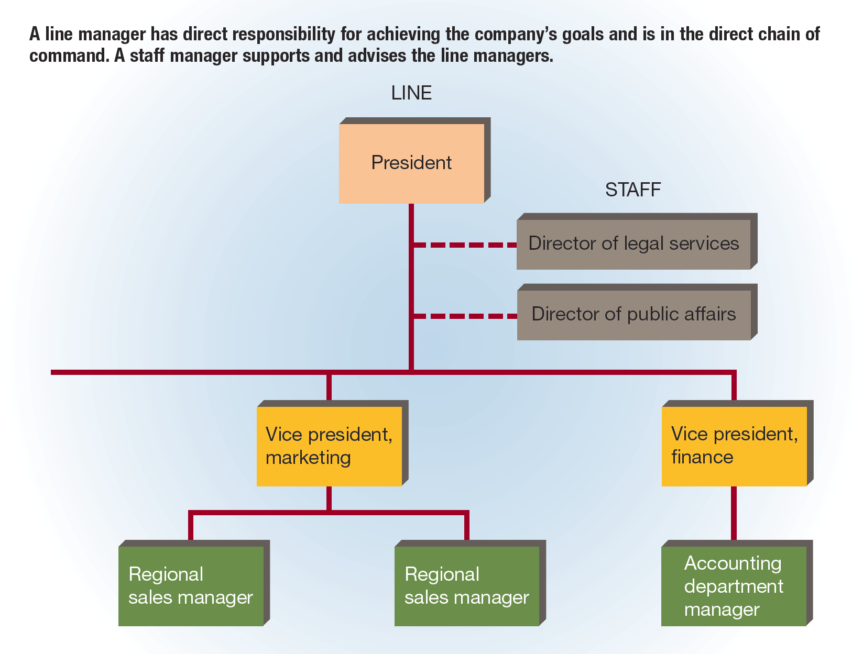
FIGURE 7-5 Line and Staff Managers

Slide 29
The Line-and-Staff Structure (slide 2 of 3)
Line managers have line authority.
Line authority – the ability to make decisions and issue directives relating to the organization’s goals
Staff managers have either advisory authority or functional authority.
Advisory authority – the expectation that line managers will consult the appropriate staff manager when making decisions
Functional authority – the authority of staff managers to make decisions and issue directives about their areas of expertise
Staff managers in a line-and-staff structure tend to have access to more information than line managers.

Slide 30
The Line-and-Staff Structure (slide 3 of 3)
Conflict between line managers and staff managers is fairly common.
Ways to minimize the likelihood of conflict:
Integrate line and staff managers into one team.
Ensure that the areas of responsibility of line and staff managers are clearly defined.
Hold both line and staff managers accountable for the results of their activities.

Slide 31
The Matrix Structure (slide 1 of 2)
Matrix structure – an organizational structure that combines vertical and horizontal lines of authority, usually by superimposing product departmentalization on a functionally departmentalized organization
Cross-functional team – a team of individuals with varying specialties, expertise, and skills that are brought together to achieve a common task
Project manager – the manager in charge of a cross-functional team
Any individual who is working with the team reports to both the project manager and the individual’s superior in the functional department.
Cross-functional team projects may be temporary and disbanded once the mission is accomplished, or they may be permanent.

Slide 32
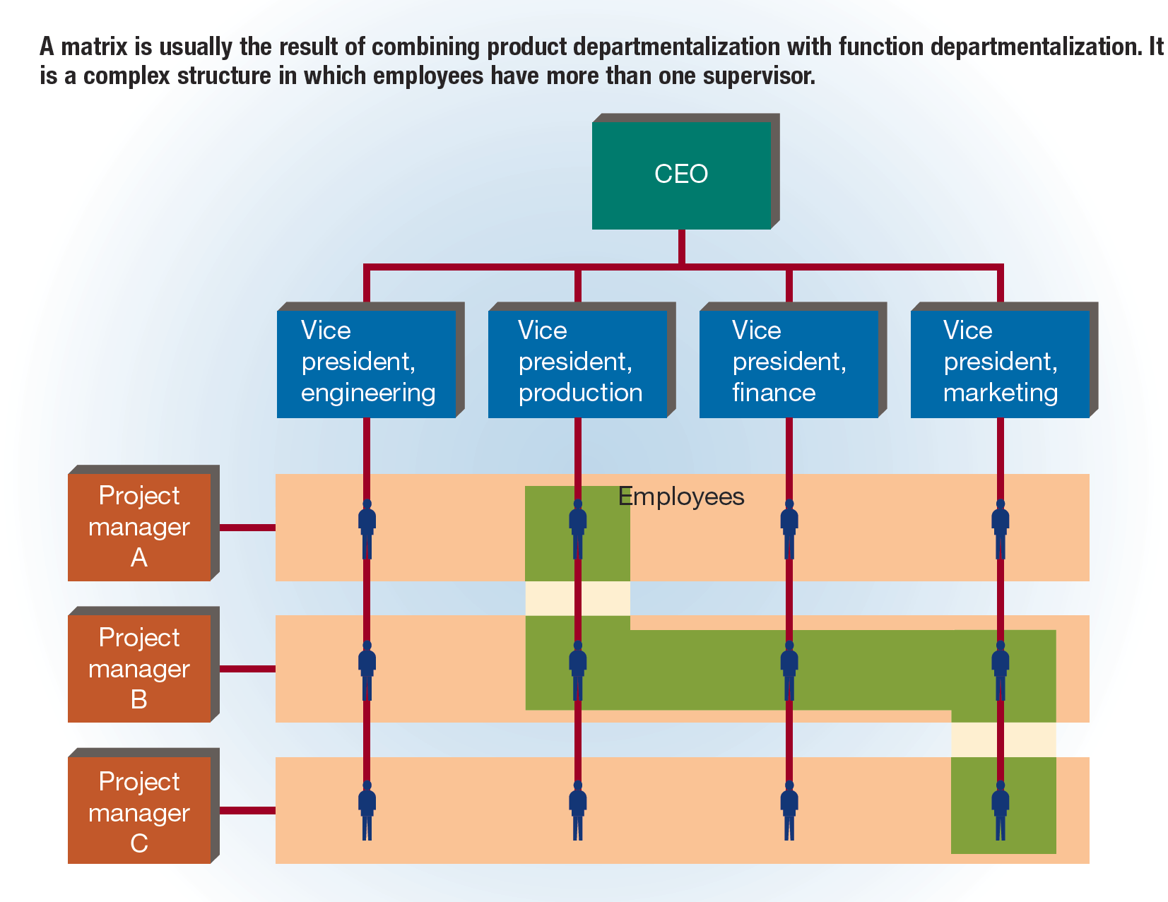
FIGURE 7-6 A Matrix Structure

Slide 33
The Matrix Structure (slide 2 of 2)
Advantages:
Adds flexibility
Increases productivity
Raises morale
Nurtures creativity and innovation
Personal development experienced by employees
Disadvantages:
Chain of command conflicts
May take longer to resolve problems and issues
Personality clashes
Poor communication
Undefined individual roles
Unclear responsibilities
Difficulties in finding ways to reward individual and team performance simultaneously
Expensive to maintain

Slide 34
The Network Structure
Network structure (virtual organization) – an organizational structure in which administration is the primary function, and most other functions are contracted out to other firms
This type of organization has a few permanent employees consisting of top management and hourly clerical workers.
Leased facilities and equipment, as well as temporary workers, are increased or decreased as the organization’s needs change.
Advantages:
Flexibility that allows organizations to adjust quickly to changes
More likely to survive the loss of an important member
Disadvantages:
Lack of control over quality of work
Low morale and high turnover among hourly workers
Lack of a clear hierarchy

Slide 35
Corporate Culture
Corporate culture – the inner rites, rituals, heroes, and values of a firm
An organization’s culture has a powerful influence on how employees think and act.
It also can determine public perception of the organization.
Common corporate culture indicators:
Physical setting (building or office layouts)
What the company says about its corporate culture (in advertising or news releases)
How the company greets guests (formal or informal reception areas)
How employees spend their time (working alone in an office or working with others)

Slide 36
FIGURE 7-7 Types of Corporate Culture

Slide 37
Committees and Task Forces (slide 1 of 2)
Ad hoc committee – a committee created for a specific short-term purpose
Example: a committee established for reviewing the firm’s employee benefits plan
Standing committee – a relatively permanent committee charged with performing some recurring task
Example: a budget review committee established to review departmental budget requests on an ongoing basis
Task force – a committee established to investigate a major problem or pending decision
Example: a committee established to assess the pros and cons of a merger with another company

Slide 38
Committees and Task Forces (slide 2 of 2)
Advantages:
Different knowledge and skills brought by members to the task at hand
Tend to make more accurate decisions
Tend to transmit their results through the organization more effectively
Disadvantages:
Longer deliberations
The possibility of unnecessary compromise
The possibility of domination by one person

Slide 39
The Informal Organization and the Grapevine
Informal organization – the pattern of behavior and interaction that stems from personal rather than official relationships
Embedded with every informal organization are informal groups and the notorious grapevine.
Informal group – a group created by the members themselves to accomplish goals that may or may not be relevant to an organization
Informal groups can be powerful forces in organizations, exerting both positive influences (e.g., boosting morale and job satisfaction) and negative influences (e.g., causing disagreement and conflict).
Grapevine – the informal communications network within an organization

