Slide 1
Chapter 6 Understanding the Management Process

Slide 2
What Is Management?
Management – the process of coordinating people and other resources to achieve the goals of an organization
Most organizations make use of four kinds of resources:
Material resources – the tangible, physical resources an organization uses
Example: General Motors uses steel, glass, and fiberglass to produce cars and trucks on machine-driven assembly lines.
Human resources – people
Financial resources – the funds an organization uses to meet its obligations to investors and creditors
Example: A 7-Eleven convenience store obtains money from customers at the checkout counter and uses a portion to pay its employees and suppliers.
Informational resources

Slide 3
FIGURE 6-1 The Four Main Resources of Management

Slide 4
Today’s Managers
Younger and more progressive.
Growing numbers of women.
Fewer from elite universities.
Emphasis is on teams and team building.
Managers need to be skilled communicators and team players.

Slide 5
FIGURE 6-2 The Management Process
How well managers perform these key management process functions determines whether a business is successful

Slide 6
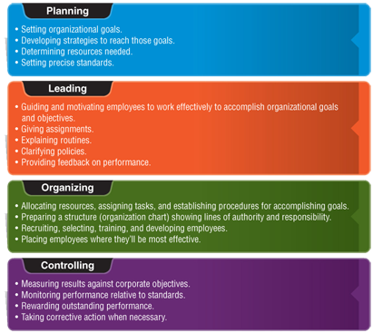
Four Management Functions: An Overview

Slide 7
Planning
Planning – establishing organizational goals and deciding how to accomplish them
Mission – a statement of the basic purpose that makes an organization different from others
Example mission statements:
Starbucks: “to inspire and nurture the human spirit—one person, one cup, and one neighborhood at a time”
Amazon.com: “to be Earth’s most customer-centric company where people can find and discover anything they want to buy online”
Twitter: “to give everyone the power to create and share ideas and information instantly, without barriers”

Slide 8
Planning
Strategic Planning Process
Strategic planning process – the establishment of an organization’s major goals and objectives and the allocation of resources to achieve them
Goal – an end result that an organization is expected to achieve over a one- to ten-year period
Example: Ulta has a five-year plan to open 100 new stores a year.
Objective – a specific statement detailing what an organization intends to accomplish over a shorter period of time
Goals in different departments and at different levels may conflict—it is the manager’s job to achieve balance, which is called optimization.

Slide 9
Planning
SWOT Analysis
SWOT analysis – the identification and evaluation of a firm’s strengths, weaknesses, opportunities, and threats
Strengths refer to a firm’s favorable characteristics and core competencies.
Core competencies – approaches and processes that a company performs well that may give it an advantage over its competitors
Weaknesses refer to internal limitations a company faces in developing or implementing plans.
Opportunities refer to favorable conditions in the environment that could benefit the organization if properly exploited.
Threats are conditions or barriers that may prevent the firm from reaching its objectives.

Slide 10
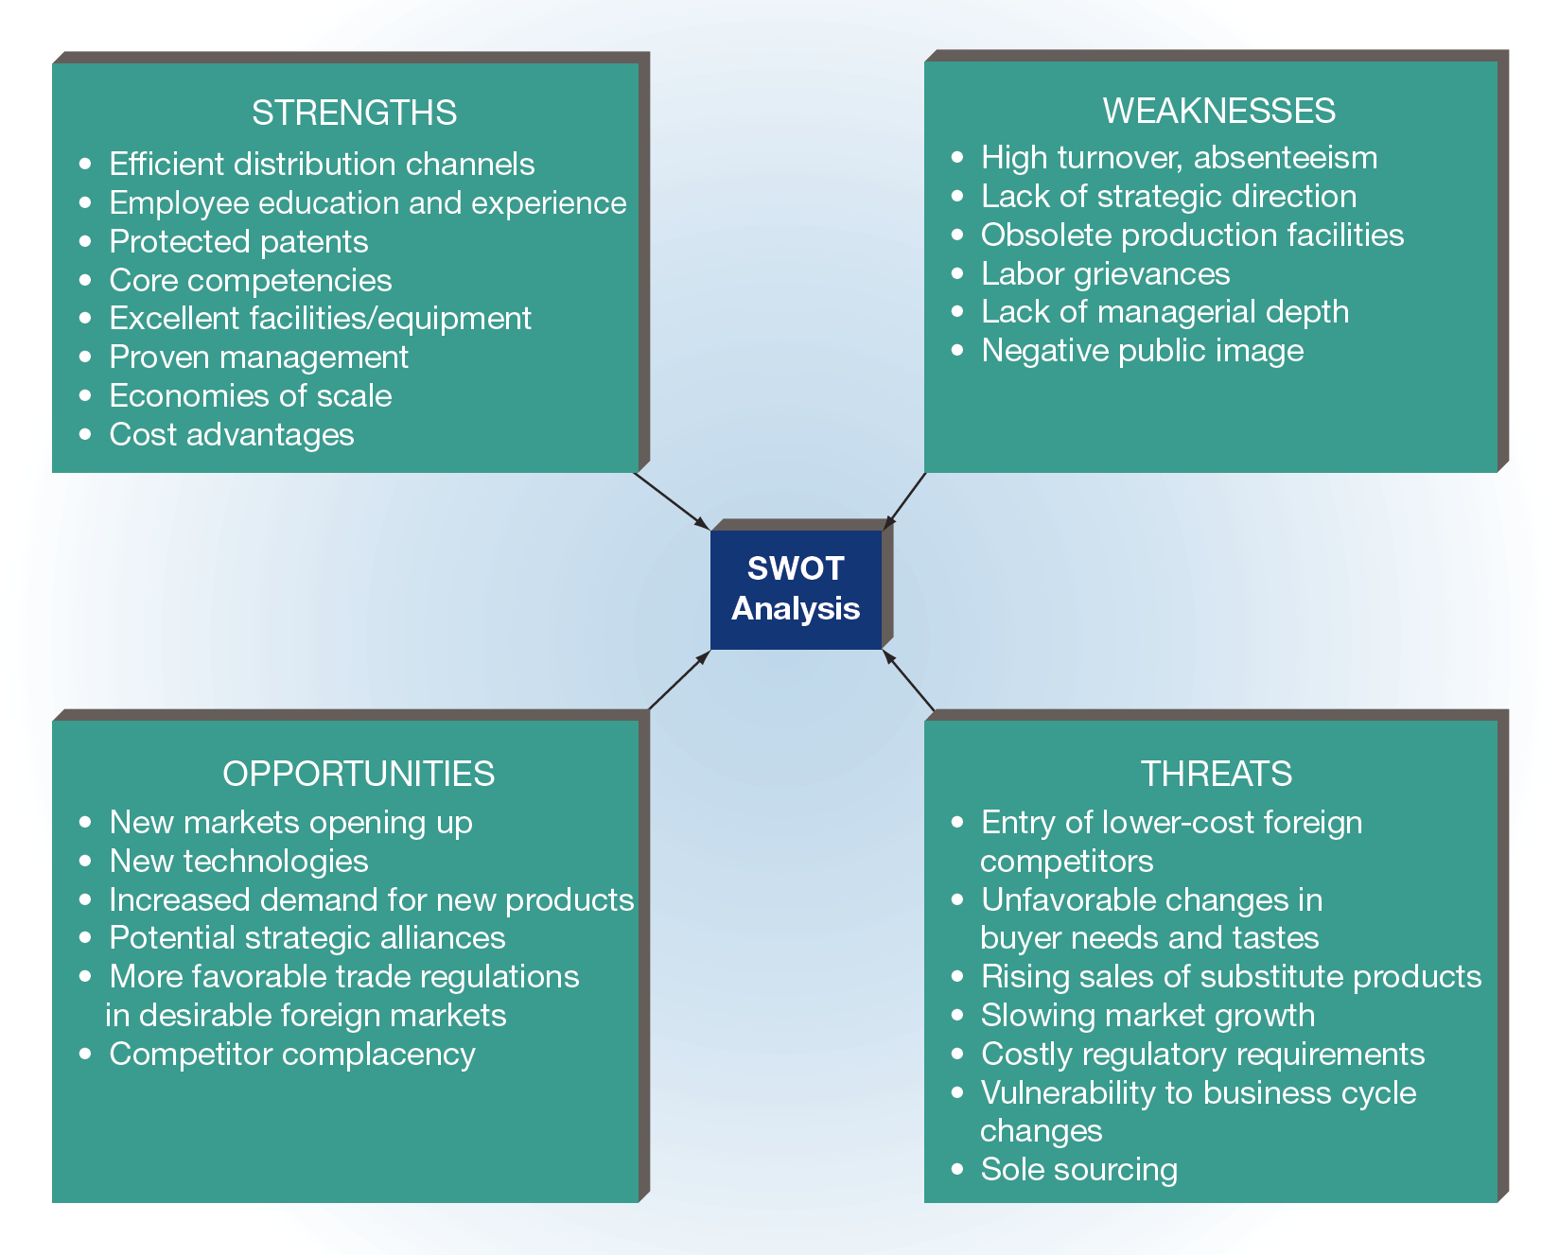
FIGURE 6-3 Elements and Examples of SWOT Analysis

Slide 11
Planning
Plans
Plan – an outline of the actions by which an organization intends to accomplish its goals and objectives
Types of Plans
Strategic plan – an organization’s broadest plan, developed as a guide for major policy setting and decision making
Example: Tesla crafted a strategic plan to first develop and introduce a viable electronic performance car (the Tesla Roadster) and then to follow with a well-made model for the luxury car market (the Model S).
Tactical plan – a smaller-scale plan developed to implement a strategy
Example: JCPenney’s CEO launched a three-year plan to bring in new customers by rolling out appliances to JCPenney stores and website.
Operational plan – a type of plan designed to implement tactical plans
Contingency plan – a plan that outlines alternative courses of action that may be taken if an organization’s other plans are disrupted or become ineffective

Slide 12
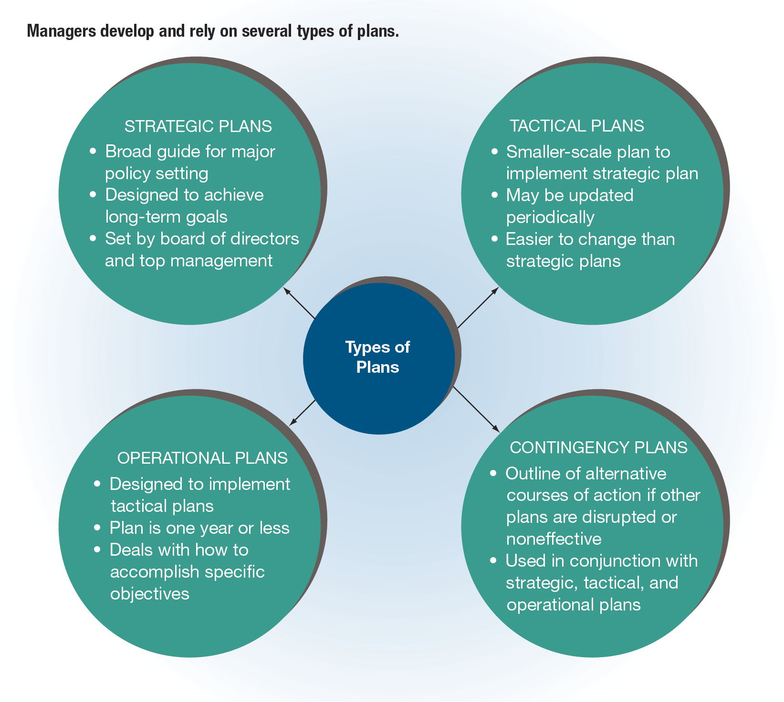
FIGURE 6-4 Types of Plans

Slide 13
Organizing the Enterprise
Organizing – the grouping of resources and activities to accomplish some end result in an efficient and effective manner
Organizing an enterprise: Putting the pieces of the puzzle together
We’ll learn more about Organizing in Ch. 7

Slide 14
Leading and Motivating
Leading – the process of influencing people to work toward a common goal
Motivating – the process of providing reasons for people to work in the best interests of an organization
Part of a manager’s job is to determine what factors motivate workers and try to provide those incentives to encourage effective performance.
Directing – the combined processes of leading and motivating

Slide 15
Controlling Ongoing Activities
Controlling – the process of evaluating and regulating ongoing activities to ensure that goals are achieved
The control function includes three steps:
Setting standards
Example: Southwest Airlines establishes a goal of increasing profits by 12 percent.
Measuring actual performance
Example: Southwest’s management will monitor its profit on a monthly basis to ensure success.
Taking corrective action
Example: After three months, Southwest’s management finds that profit has increased only 1 percent; thus, corrective action will be needed to get the firm back on track.

Slide 16
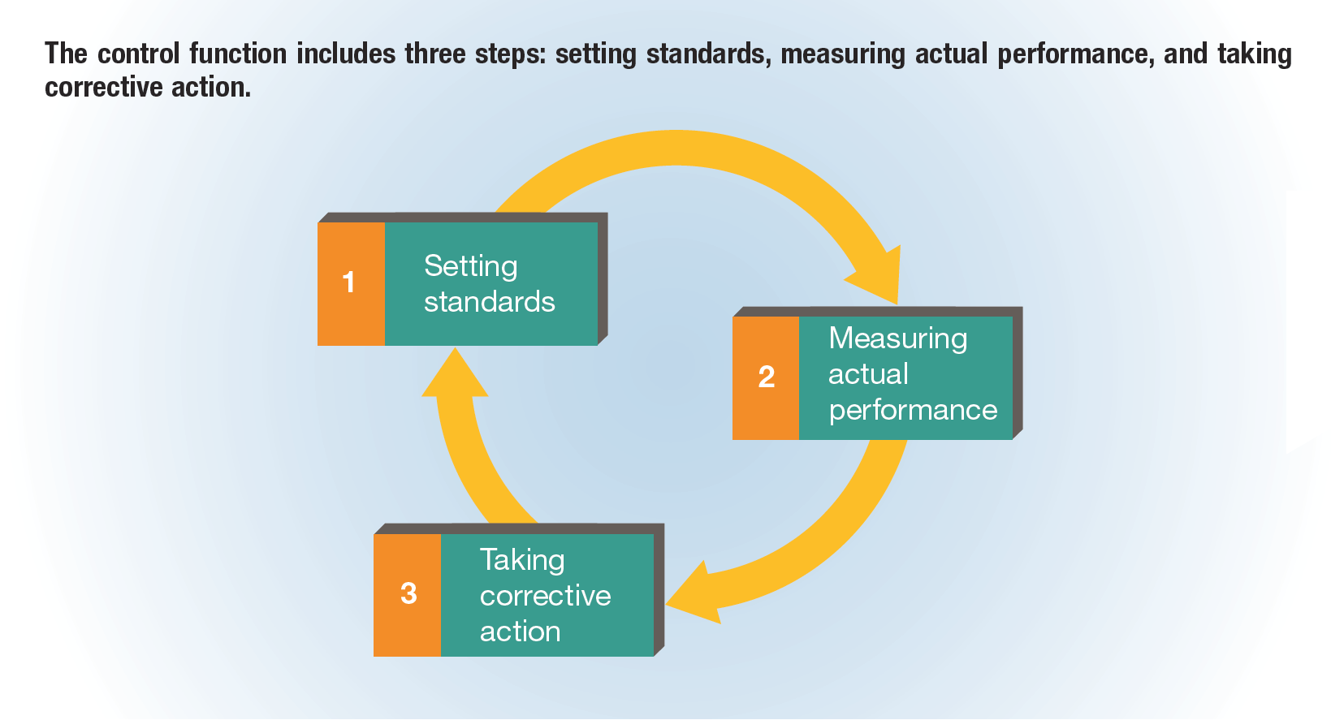
FIGURE 6-5 The Control Function

Slide 17
Kinds of Managers
Managers can be classified according to their:
Level within an organization
Area of management

Slide 18
Levels of Management
Top manager – an upper-level executive who guides and controls the overall fortunes of an organization
Generally responsible for developing the organization’s mission
Determines the firm’s strategy
Common titles: president, vice president, chief executive officer (CEO)
Middle manager – a manager who implements the strategy and major policies developed by top management
Develops tactical and operational plans
Coordinates and supervises the activities of first-line managers
Common titles: division manager, plant manager, operations manager
First-line manager – a manager who coordinates and supervises the activities of operating employees
Spends most time working with and motivating employees, answering questions, and solving day-to-day problems
Common titles: office manager, supervisor, foreman

Slide 19
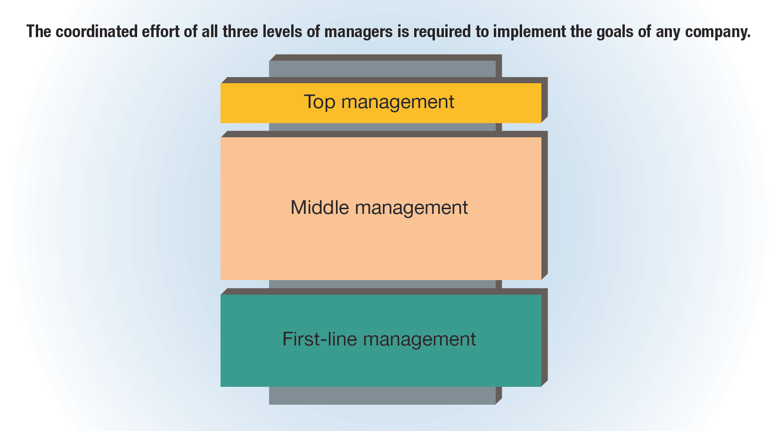
FIGURE 6-6 Management Levels Found in Most Companies

Slide 20
Areas of Management Specialization
Financial manager – a manager who is primarily responsible for an organization’s financial resources
Operations manager – a manager who manages the systems that convert resources into goods and services
Marketing manager – a manager who is responsible for facilitating the exchange of products between an organization and its customers or clients
Human resources manager – a person charged with managing an organization’s human resources programs
Administrative manager – a manager who is not associated with any specific functional area but who provides overall administrative guidance and leadership

Slide 21
FIGURE 6-7 Areas of Management Specialization

Slide 22
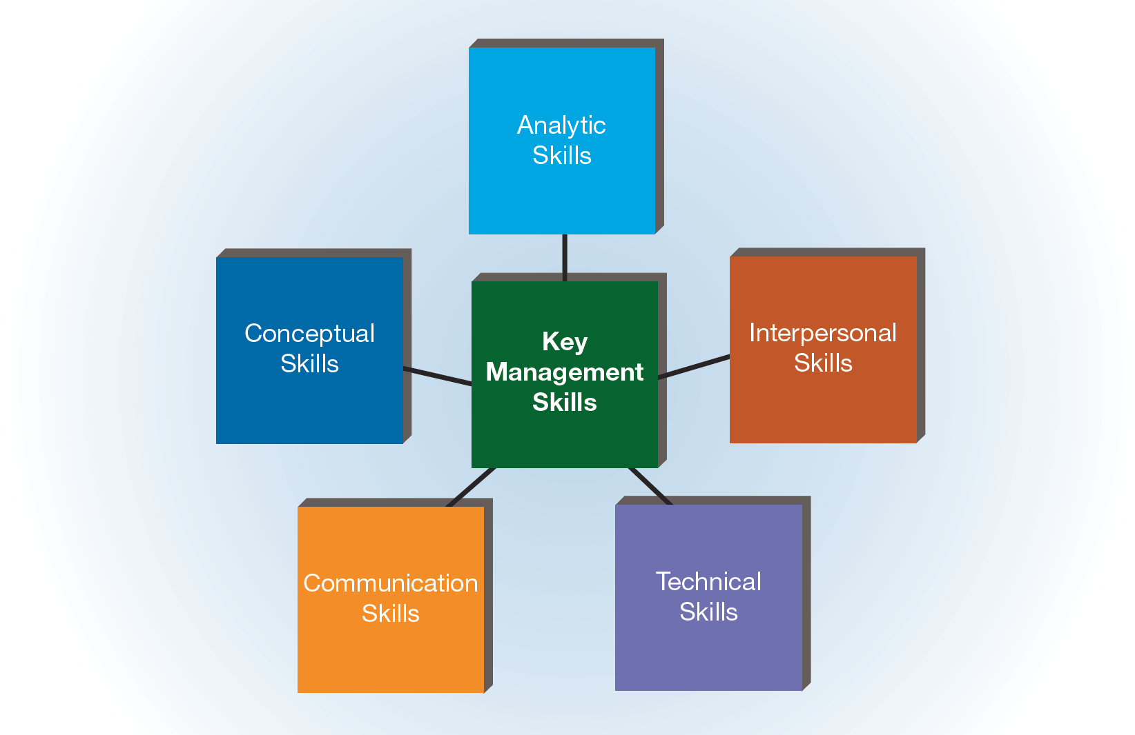
FIGURE 6-8 Key Skills of Successful Managers

Slide 23
Conceptual Skills
Conceptual skills – the ability to think in abstract terms
Conceptual skills allow a manager to see the “big picture” and understand how the various parts of an organization or idea can fit together.
Example: Although it initially operated in the red, Amazon.com founder Jeff Bezos never lost sight of his vision of an Internet commerce site where people could shop quickly and easily.

Slide 24
Analytic Skills
Analytic skills – the ability to identify problems correctly, generate reasonable alternatives, and select the “best” alternatives to solve problems
Example: When Lee Bird became the CEO of At Home Group (formerly known as Garden Ridge), he quickly identified a number of issues that were contributing to stagnating sales of Garden Ridge home décor stores. By identifying alternatives and solutions to these issues and then setting about updating the stores, he helped At Home boost revenues and allowed it to go public with an initial stock offering.

Slide 25
Interpersonal Skills
Interpersonal skills – the ability to deal effectively with other people
Examples of interpersonal skills are the ability to:
Relate to people
Understand their needs and motives
Show genuine compassion

Slide 26
Technical Skills
Technical skills – specific skills needed to accomplish a specialized activity
First-line managers (and, to a lesser extent, middle managers) need to understand the technical skills relevant to the activities they manage in order to train subordinates, answer questions, and provide guidance, even though the managers may not perform the technical tasks themselves.

Slide 27
Communication Skills
Communication skills – the ability to speak, listen, and write effectively
Managers need both oral and written communication skills.
Oral communication skills are used when a manager makes sales presentations, conducts interviews, and holds press conferences.
Written communication skills are important because a manager’s ability to prepare letters, emails, memos, sales reports, and other written documents may spell the difference between success and failure.

Slide 28
Leadership
Leadership – the ability to influence others
Leadership is different from management in that a leader strives for voluntary cooperation, whereas a manager may have to depend on coercion to change employee behavior.

Slide 29
Formal and Informal Leadership
Formal leaders
Have legitimate power of position
Have authority within an organization to influence others to work toward the organization’s objectives
Informal leaders
Do not have authority to influence others to work toward the organization’s objectives
May or may not exert their influence in support of the organization
Both formal and informal leaders make use of several kinds of power, including:
The ability to grant rewards or impose punishments
The possession of expert knowledge
Personal attraction or charisma

Slide 30
Styles of Leadership (slide 1 of 2)
Autocratic leadership – task-oriented leadership style in which workers are told what to do and how to accomplish it without having a say in the decision-making process
Entrepreneurial leadership – personality-based leadership style in which the manager seeks to inspire workers with a vision of what can be accomplished to benefit all stakeholders
Although each entrepreneur is different, this leadership style is generally task-oriented, driven, charismatic, and enthusiastic.
The entrepreneurial personality tends to take initiative, be visionary, and be forward-looking.
Entrepreneurial leaders tend to be very invested in their businesses.
Participative leadership – leadership style in which all members of a team are involved in identifying essential goals and developing strategies to reach those goals
Participative leadership can be classified into three groups:
Consultative leaders – discuss issues with workers but retain the final authority for decision making
Consensus leaders – seek input from almost all workers and make final decisions based on their support
Democratic leaders – give final authority to the group

Slide 31
Which Leadership Style Is the Best?
Most management experts agree that no “best” managerial leadership style exists.
The most effective style depends on the right balance between:
Interaction among employees
Characteristics of the work situation
The manager’s personality

Slide 32
Managerial Decision Making
Decision making – the act of choosing one alternative from a set of alternatives
FIGURE 6-9 Major Steps in the Managerial Decision-Making Process

Slide 33
Identifying the Problem or Opportunity
Problem – the discrepancy between an actual condition and a desired condition
Most people consider a problem to be “negative,” but a problem can also be “positive.”
This stage of decision making creates many difficulties for managers.
Sometimes managers’ preconceptions of the problem prevent them from seeing the actual situation.
They produce an answer before the proper question has been asked, leading them to focus on insignificant issues.
Managers may mistakenly analyze problems in terms of symptoms rather than underlying causes.
Effective managers clarify situations, examine the causes of problems, and consider how individual behaviors and values affect the way problems or opportunities are defined.

Slide 34
Generating Alternatives
The more important the decision, the more attention must be devoted to this stage.
Certain techniques can aid in the generation of creative alternatives.
Brainstorming
“Blast! Then Refine”
An approach developed by the U.S. Navy in which group members tackle a recurring problem by erasing all previous solutions and procedures, then re-evaluate its original objectives, modify them if necessary, and devise new solutions.
Trial and error

Slide 35
Selecting an Alternative
Final decisions are influenced by a number of considerations, including:
Financial constraints
Human and informational resources
Time limits
Legal obstacles
Political factors
Managers must select the alternative that will be most effective and practical.
When lacking time or information, managers often “satisfice”—choose solutions that are only adequate and not ideal.

Slide 36
Implementing and Evaluating the Solution
If the alternative that was chosen removes the difference between the actual condition and the desired condition, the decision is considered effective.
If the problem still exists, managers may:
Decide to give the chosen alternative more time to work.
Adopt a different alternative.
Start the problem identification process all over again.
Managers should be aware that failure to evaluate decisions adequately may have negative consequences.

Slide 37
Managing Total Quality (slide 1 of 2)
Total quality management (TQM) – the coordination of efforts directed at improving customer satisfaction, increasing employee participation, strengthening supplier partnerships, and facilitating an organizational atmosphere of continuous quality improvement
Benchmarking – a process used to evaluate the products, processes, or management practices of another organization that is superior in some way in order to improve quality
The basic steps in benchmarking involve identifying objectives, forming a benchmarking team, collecting and analyzing data, and acting on the results.

Slide 38
Managing Total Quality (slide 2 of 2)
Although many factors influence the effectiveness of a TQM program, two issues are crucial.
Top management must make a strong commitment to a TQM program by treating quality improvement as a top priority and giving it frequent attention.
Management must coordinate the specific elements of a TQM program so that they work in harmony with each other.
Financial benefits of TQM programs:
Lower operating costs
Higher return on sales and on investments
An improved ability to use premium pricing rather than competitive pricing

