Slide 1
Chapter 4 Choosing a Form of Business Ownership

Slide 2
Major Forms of Business
Sole Proprietorship -- A business owned, and usually managed, by one person.
Partnership -- Two or more people legally agree to become co-owners of a business.
Corporation (C-Corp) -- A legal entity with authority to act and have liability apart from its owners.
S Corporation (S-Corp) -- A unique government creation that looks like a corporation but is taxed like sole proprietorships and partnerships
Limited Liability Company (LLC) -- A company similar to an S-corporation but without the special eligibility requirements
Owning a
Business
The Five
Most Common Forms –
The designated type of
business as it is
operated in regards to tax
& liability reasons

Slide 3
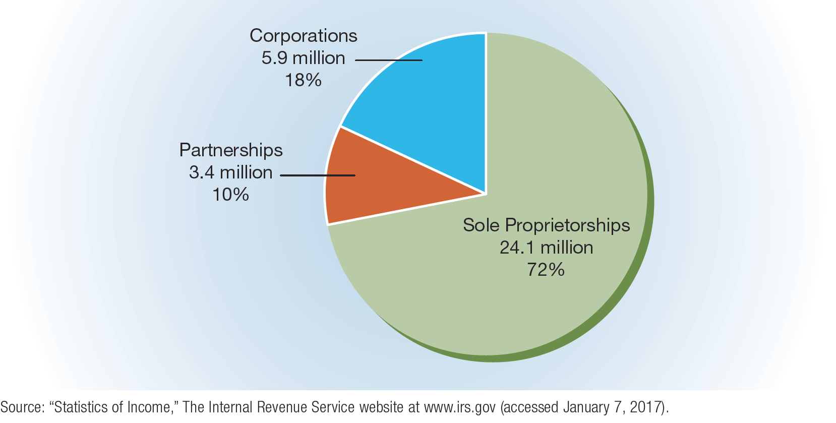
FIGURE 4-1 Relative Percentages of Sole Proprietorships, Partnerships, and Corporations in the United States

Slide 4
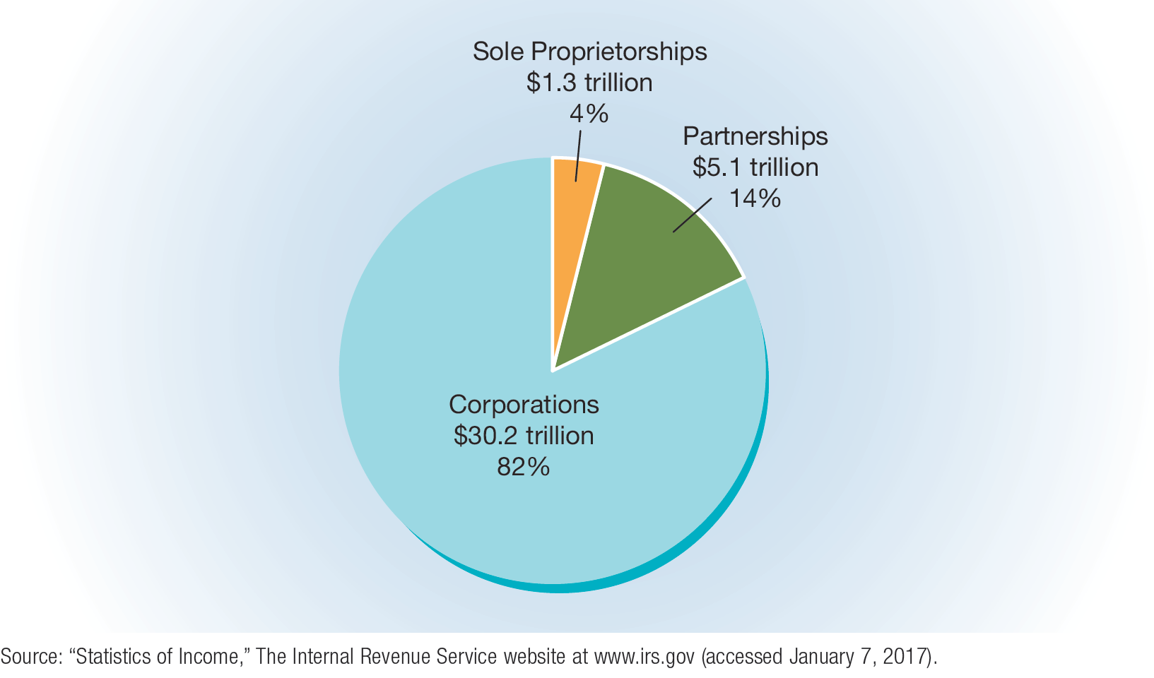
FIGURE 4-2 Total Sales Receipts of Sole Proprietorships, Partnerships, and Corporations in the United States

Slide 5
Sole Proprietorships
Sole proprietorship – a business that is owned (and usually operated) by one person
Although a few sole proprietorships are large and have many employees, most are small.
Some of today’s largest corporations, including Walmart and JCPenney, started out as sole proprietorships.
Sole proprietorships are the most popular form of ownership when compared to partnerships and corporations, but they rank last in sales revenues.

Slide 6
Advantages and Disadvantages of Sole Proprietorships
Advantages
Ease of start-up and closure
Pride of ownership
Retention of all profits
No special taxes
Flexibility of being your own boss
Disadvantages
Unlimited liability
Any debts or damages incurred by the business are your debts, even if it means selling your home, car or anything else (i.e. the owner is personally responsible for the debts of the business)
Lack of continuity
Lack of money
Limited management skills
Difficulty in hiring employees

Slide 7
Partnerships
Partnership – a voluntary association of two or more persons to act as co-owners of a business for profit
Example: Before becoming incorporated, Procter & Gamble was formed as a partnership.
This form of ownership is much less common than the sole proprietorship or the corporation, representing only about 10 percent of all American businesses.
There is no legal maximum on the number of partners a partnership may have.
Large accounting, law, and advertising partnerships have multiple partners
Partnerships are usually a pooling of special talents or the result of a sole proprietor taking on a partner

Slide 8
Types of Partners and Partnerships
General partner – a person who assumes full or shared responsibility for operating a business
General partnership: a business co-owned by two or more general partners who are liable for everything the business does
Limited partner – a person who invests money in a business but has no management responsibility or responsibility or liability for losses beyond the amount he or she invested in the partnership
Limited partnership: a business co-owned by one or more general partners who manage the business and limited partners who invest money in it (but have no personal liability)

Slide 9
The Partnership Agreement
Articles of partnership – an agreement listing and explaining the terms of the partnership
The partnership agreement should state:
Who will make the final decisions
What each partner’s duties will be
The investment each partner will make
How much profit or loss each partner receives or is responsible for
What happens if a partner wants to dissolve the partnership or dies

Slide 10
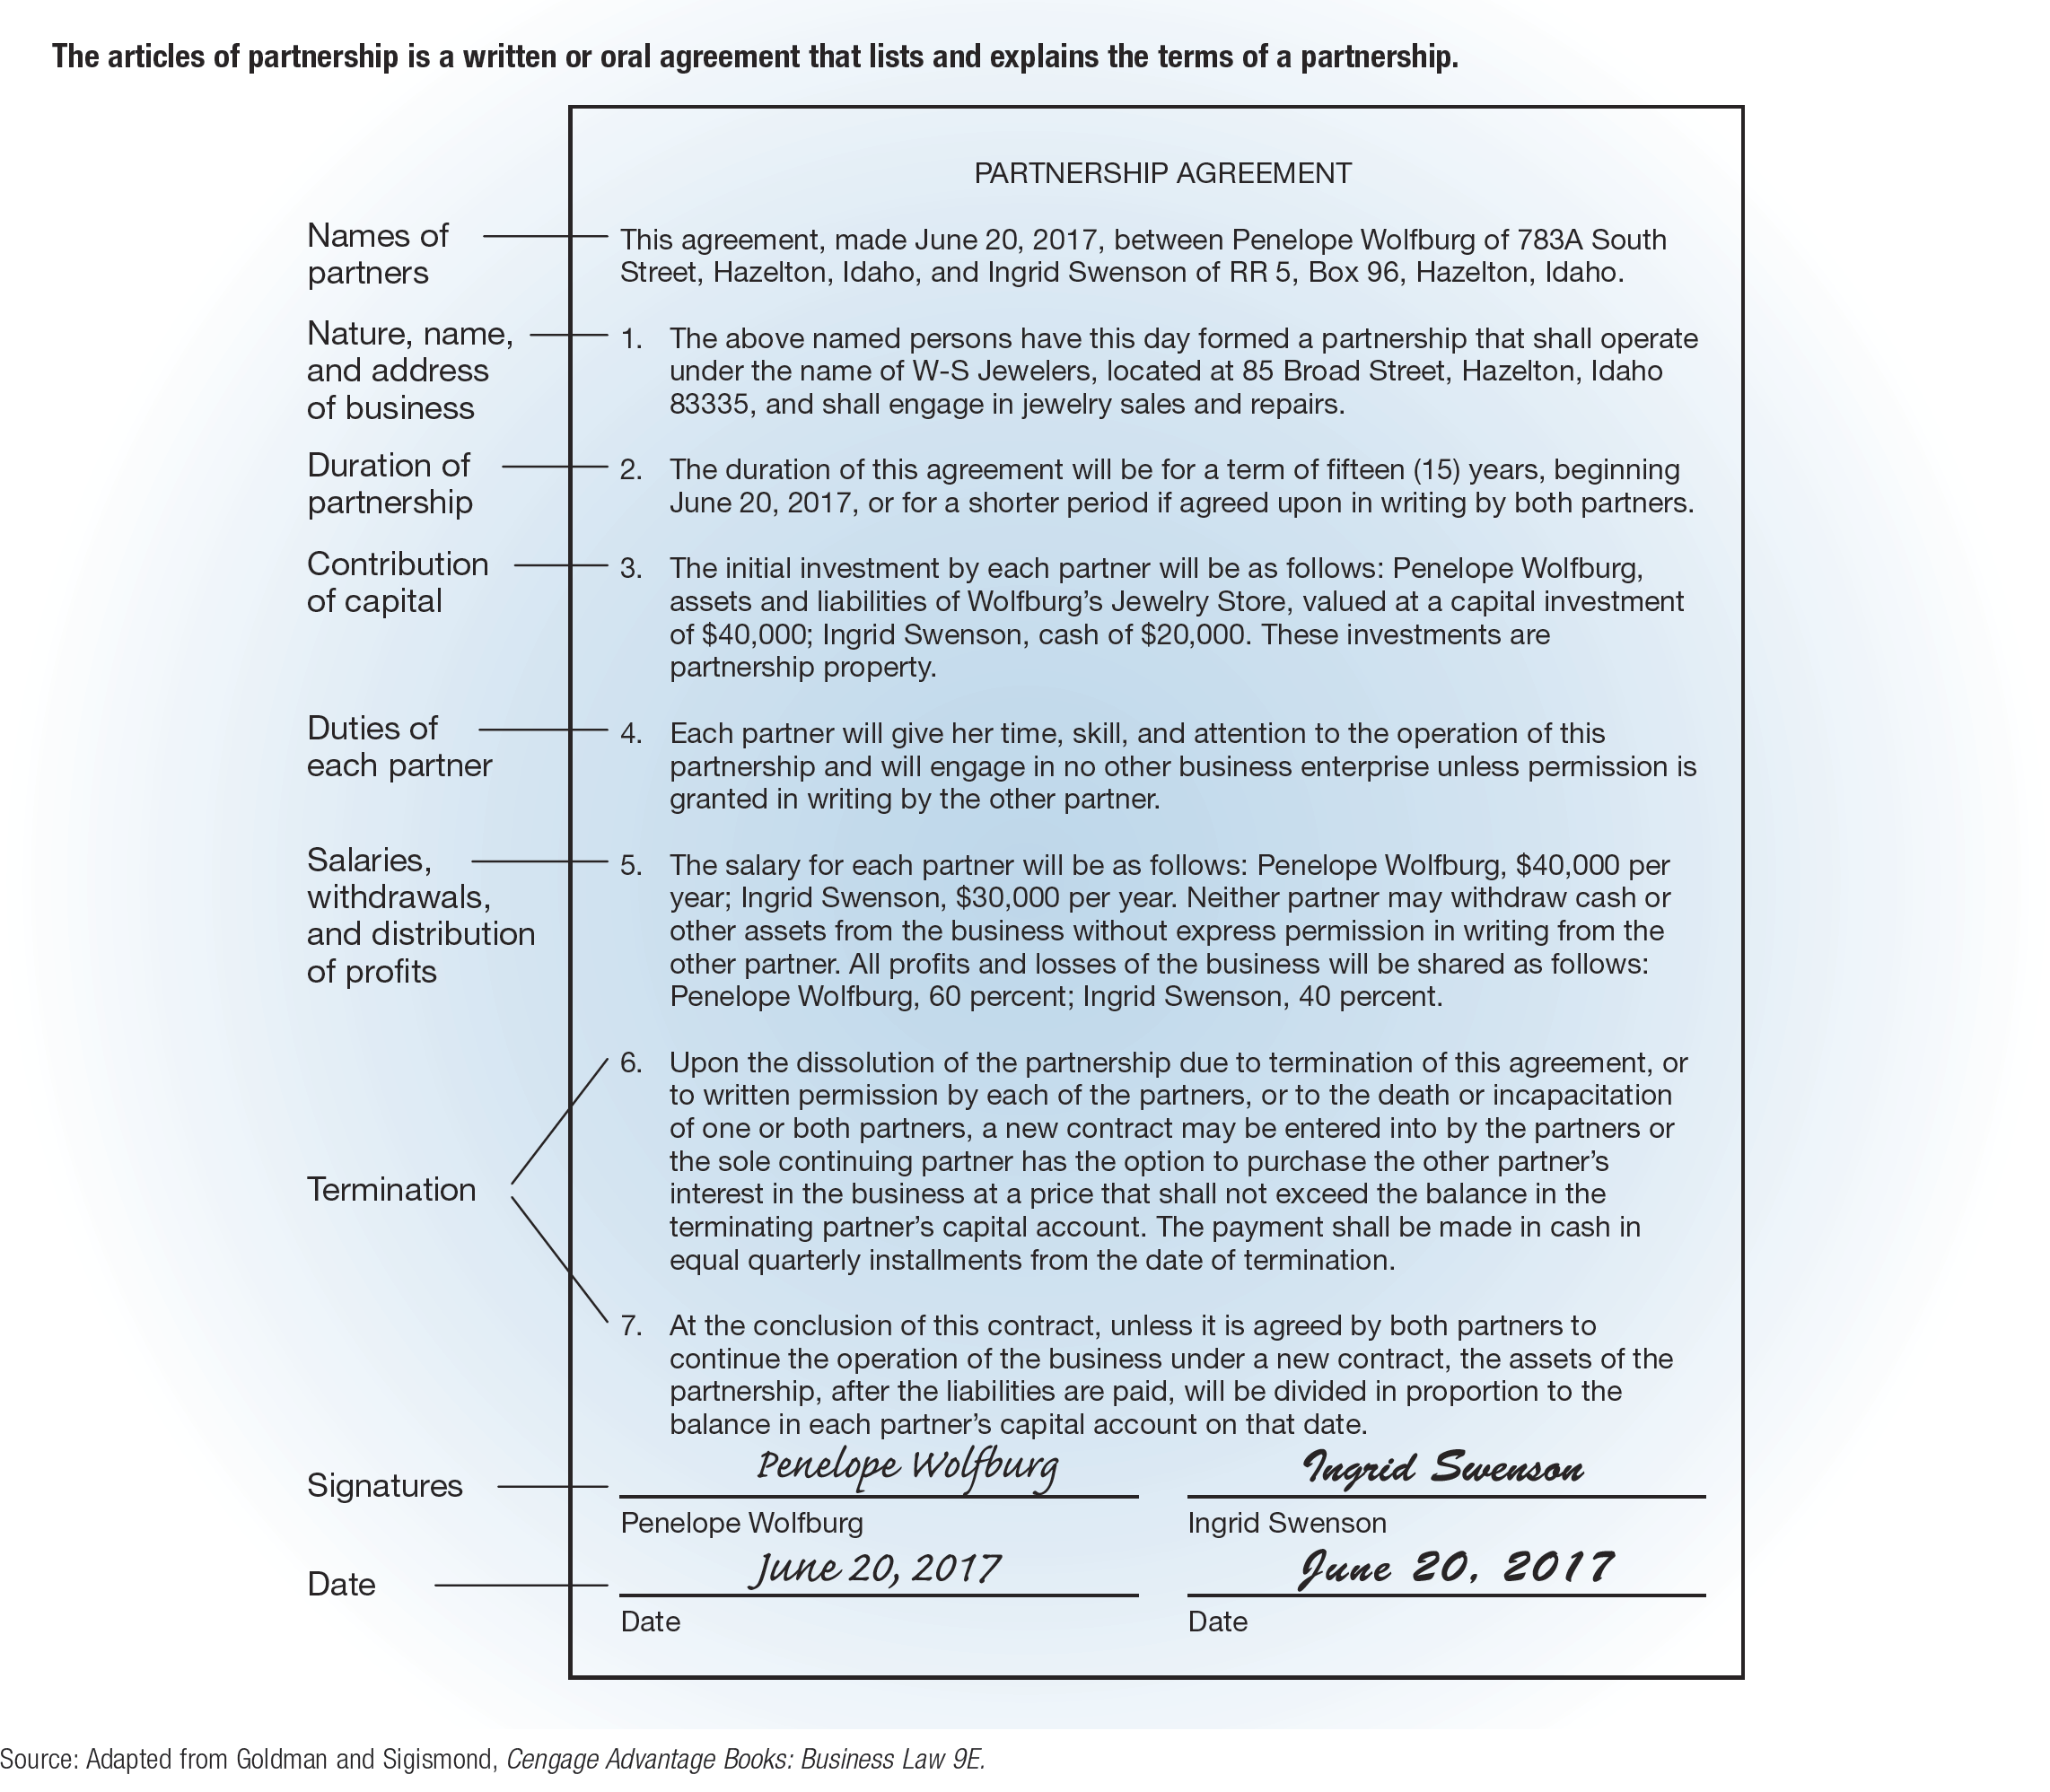
FIGURE 4-3 Articles of Partnership

Slide 11
Picking the Right Partner
There is no such thing as a perfect partner but ask these questions when you try to find your best match:
Do you share the same goals?
Do you share the same vision for the company?
What skills does he/she have? Are yours the same?
What can he/she bring to the business?
What type of decision maker is he/she?
Do you trust each other?
How does he/she problem solve?

Slide 12
Advantages and Disadvantages of Partnerships
Advantages
Ease of start-up
Availability of capital and credit
Personal interest
Combined business skills and knowledge
Retention of profits
No special taxes
Disadvantages
Unlimited liability
Management disagreements
Lack of continuity
Frozen investment

Slide 13
Corporations
Corporation – an artificial person created by law with most of the legal rights of a real person, including the rights to start and operate a business, to buy or sell property, to borrow money, to sue or be sued, and to enter into binding contracts
Unlike a real person, a corporation exists only on paper.
Corporations comprise about 18 percent of all businesses, but they account for 82 percent of sales revenues.
Most common type of corporation is a “C” corporation
A corporation is a legal entity, separate from its owners
Requirements vary by state, many states are “corporation-friendly”
Corporations are owned by stockholders
Articles of incorporations must be filed and corporate bylaws adopted

Slide 14
Corporate Ownership
Stock – the shares of ownership of a corporation
Two Types: 1) Common Stock (voting privileges), 2) Preferred Stock (no voting rights, dividends paid first)
Stockholder – a person who owns a corporation’s stock
Dividend: A portion of the corporation’s profit (earnings) that is distributed to stockholders
Closed corporation – a corporation whose stock is owned by relatively few people and is not sold to the general public
Example: Mars
Open corporation – a corporation whose stock can be bought and sold by any individual
Examples: General Electric, Microsoft, Nike

Slide 15
TABLE 4-1 Ten Aspects of Business That May Require Legal Help
Choosing either the sole proprietorship, partnership, corporate, or some special form of ownership
Constructing a partnership agreement
Incorporating a business
Registering a corporation’s stock
Obtaining a trademark, patent, or copyright
Filing for licenses or permits at the local, state, and federal levels
Purchasing an existing business or real estate
Creating valid contracts
Hiring employees and independent contractors
Extending credit and collecting debts

Slide 16
Forming a Corporation: Where to Incorporate?
A business can incorporate in any state it chooses
The decision is usually based on cost and the advantages and disadvantages of each state’s corporate laws and tax structure
A domestic corporation is a corporation in the state in which it is incorporated
A foreign corporation is a corporation in any state in which it does business except the one in which it is incorporated
An alien corporation is a corporation chartered by a foreign government and conducting business in the United States

Slide 17
Forming a Corporation: The Corporate Charter
The Corporate Charter
Articles of incorporation – a contract between a corporation and the state in which the state recognizes the formation of the artificial person that is the corporation (often called a corporate charter)
Usually, the articles of incorporation include the following information:
The firm’s name and address
The incorporators’ names and addresses
The purpose of the corporation
The maximum amount of stock and types of stock to be issued
The rights and privileges of stockholders
The length of time the corporation is to exist

Slide 18
Corporate Structure
In a corporation, both the board of directors and the corporate officers are involved in management.
Board of directors – the top governing body of a corporation, the members of which are elected by the stockholders
Board members can be chosen from within the corporation or from outside it.
Their major responsibilities are to set company goals, develop general plans (or strategies) for meeting those goals, oversee the firm’s overall operation, and appoint corporate officers.
Corporate officers – the chairman of the board, president, executive vice presidents, corporate secretary, treasurer, and any other top executive appointed by the board of directors
They help the board to make plans, carry out strategies established by the board, hire employees, and manage day-to-day business activities.

Slide 19
FIGURE 4-4 Hierarchy of Corporate Structure

Slide 20
Advantages of Corporations
Limited liability – a feature of corporate ownership that limits each owner’s financial liability to the amount of money that he or she has paid for the corporation’s stock
Ease of raising capital
Corporations can not only borrow money but also raise additional sums of money by selling stock.
Ease of transfer of ownership
Perpetual life
Since it is essentially a legal “person,” a corporation exists independently of its owners and survives them.
Specialized management
Typically, corporations are able to recruit more skilled, knowledgeable, and talented managers than proprietorships and partnerships.

Slide 21
Disadvantages of Corporations
Difficulty and expense of formation
Government regulation and increased paperwork
A corporation must register and meet various government standards before it can sell its stock to the public.
Conflict within the corporation
Double taxation
Corporate profits are taxed twice—once as corporate income and a second time as the personal income of stockholders.
Lack of secrecy
Because open corporations are required to submit detailed reports to government agencies and to stockholders, competitors can use this information to compete more effectively.

Slide 22
TABLE 4-2 Some Advantages and Disadvantages of a Sole Proprietorship, Partnership, and Corporation
 | Sole Proprietorship | General Partnership | Regular C-Corporation
Protecting against liability for debts | Difficult | Difficult | Easy
Raising money | Difficult | Difficult | Easy
Ownership transfer | Difficult | Difficult | Easy
Preserving continuity | Difficult | Difficult | Easy
Government regulations | Few | Few | Many
Formation | Easy | Easy | Difficult
Income taxation | Once | Once | Twice

Slide 23
S Corporations
S corporation – a corporation that is taxed as though it were a partnership
In other words, the corporation’s income is taxed only as the personal income of its stockholders.
S corporation criteria:
No more than 100 stockholders are allowed.
Stockholders must be individuals, estates, or certain trusts.
The corporation has no nonresident, alien shareholders.
There can be only one class of outstanding stock.
The firm must be a domestic corporation eligible to file for S corporation status.
All stockholders must agree to the decision to form an S corporation.
Becoming an S corporation can be an effective way to avoid double taxation while retaining the corporation’s legal benefit of limited liability.

Slide 24
Limited-Liability Companies
Limited-liability company (LLC) – a form of business ownership that combines the benefits of a corporation and a partnership while avoiding some of the restrictions and disadvantages of those forms of ownership
Example: BMW of North America
Advantages:
Avoids double taxation of a corporation
Retains the corporation’s legal benefit of limited liability
Provides more management flexibility and fewer restrictions than corporations
The difference between an S corporation and an LLC is that an LLC is not restricted to 100 stockholders.

Slide 25
TABLE 4-3 Some Advantages and Disadvantages of a Regular Corporation, an S Corporation, and a Limited-Liability Company
 | Regular C-Corporation | S Corporation | Limited- Liability Company
Double taxation | Yes | No | No
Limited liability and personal asset protection | Yes | Yes | Yes
Management flexibility | No | No | Yes
Restrictions on the number of owners/ stockholders | No | Yes | No
Internal Revenue Service tax regulations | Many | Many | Fewer

Slide 26
Not-for-Profit Corporations
Not-for-profit corporation – a corporation organized to provide a social, educational, religious, or other service rather than to earn a profit
Various charities, museums, private schools, colleges, and charitable organizations are organized in this way, primarily to ensure limited liability.

Slide 27
Joint Ventures
Joint venture – an agreement between two or more groups to form a business entity in order to achieve a specific goal or to operate for a specific period of time
Example: To take advantage of the production and marketing expertise of General Mills and the worldwide presence of Nestle, the two companies formed a joint venture called Cereal Partners Worldwide.
Once the goal is reached, the period of time elapses, or the project is completed, the joint venture is dissolved.

Slide 28
Syndicates
Syndicate – a temporary association of individuals or firms organized to perform a specific task that requires a large amount of capital
Example: A syndicate consisting of Goldman Sachs & Company, Morgan Stanley, J.P. Morgan, and other Wall Street firms helped U.S. Foods Holdings, a company that markets and distributes fresh, frozen, and dry food and nonfood products to consumers in the United States, sell stock to investors. With the syndicate’s help, U.S. Foods raised over $1 billion through its initial public offering and used the money to improve its cash balance and fund growth and expansion.
Like a joint venture, a syndicate is dissolved as soon as its purpose has been accomplished.

Slide 29
Growth from Within
Most corporations grow by expanding their present operations.
Some introduce and sell new but related products.
Others expand the sale of present products to new geographic markets or to new groups of consumers in geographic markets already served.
Example: Walmart was started by Sam Walton in 1962 with one discount store. Today, Walmart has nearly 11,500 stores in the United States and 27 other countries.

Slide 30
Growth Through Mergers and Acquisitions (slide 1 of 2)
Merger – the combining of two corporations or other business entities to form one business
An acquisition is essentially the same thing as a merger, but the term generally is used in reference to a large corporation’s purchases of other corporations.
To pay for an acquisition, a leveraged buyout may be used.
Leveraged buyout – a financing method that uses borrowed money to pay for the company that is being taken over
Although most mergers and acquisitions are often friendly, hostile takeovers also occur.
Hostile takeover – a situation in which the management and board of directors of a firm targeted for acquisition disapprove of the merger

Slide 31
Growth Through Mergers and Acquisitions (slide 2 of 2)
Classifications of mergers:
Horizontal merger – a merger between firms that make and sell similar products or services in similar markets
Vertical merger – a merger between firms that operate at different but related levels in the production and marketing of a product
Conglomerate merger – a merger between firms in completely different industries

Slide 32
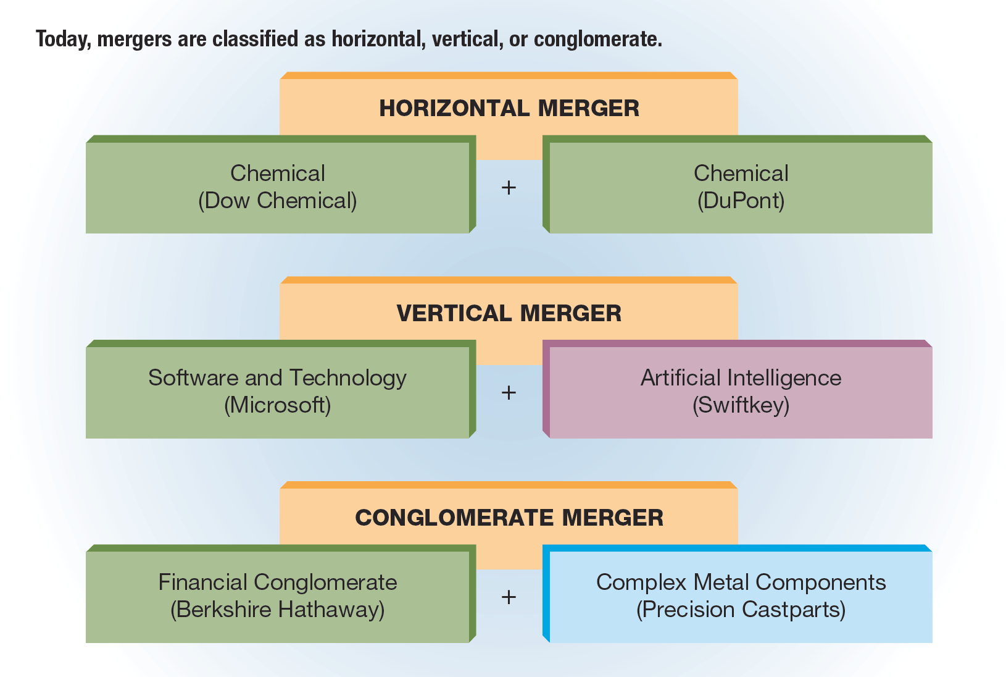
FIGURE 4-5 Three Types of Growth by Merger

Slide 33
Merger and Acquisition Trends for the Future (slide 1 of 2)
The issue of whether mergers and acquisitions are good for the economy and companies is still hotly debated.
Takeover advocates argue that:
For companies that have been taken over, the purchasers have been able to make the company more profitable and productive by installing a new top-management team, reducing expenses, and forcing the company to concentrate on the firm’s most important business activities.
Takeover opponents argue that:
Takeovers do nothing to enhance corporate profitability or productivity.
The only people who benefit from takeovers are investment bankers, brokerage firms, and takeover “artists,” who receive financial rewards by manipulating corporations rather than by producing tangible products or services.

Slide 34
Merger and Acquisition Trends for the Future (slide 2 of 2)
Most experts predict future mergers and acquisitions will be the result of cash-rich companies looking to acquire businesses that will enhance their position in the marketplace or an industry.
Analysts also anticipate more mergers that involve companies or investors from other countries.
Future mergers and acquisitions will be driven by solid business logic and the desire to compete in the international marketplace.

